Slide 1

Insights from Social Media Analytics Nanke Williams October 2023

Slide 2
Outline
Executive Summary
Introduction
Methodology
Results
Conclusion
Appendix

Slide 3

Executive Summary
Summary of methodologies
Data Collection
Data Wrangling
Exploratory Data Analysis with Visualization
Interactive Visual Analytics with Tableau
Statistical Analysis
Summary of all results
Findings from Exploratory Data Analysis
Findings from Interactive Analytics
Findings from Statistical Analytics

Slide 4

Introduction
Project background and context
Playhouse Communication is one of Nigeria's leading digital marketing agencies. They combine design and media planning with cutting-edge tech solutions to reimagine what marketing is all about.
The goal of the project is to decode a treasure trove of social media data for one of their high-profile clients and transform it into game-changing insights.
Project Deliverables
We will determine responses to Key Questions derived during Exploratory Analysis.
We will use Statistical Analysis to test whether the hypothesis raised from charts are significant and these relationships truly exist.
Make recommendations based on insights generated from Exploratory and Statistical Analysis.

Slide 5
Section 1 Methodology

Slide 6
Methodology
Executive Summary
Data preparation methodology.
Perform exploratory data analysis (EDA) with visualization
Perform interactive visual analytics using Tableau
Perform statistical analysis

Slide 7
Data Preparation
Collect Dataset
Clean Dataset
Prepare Dataset for Analysis
The dataset was collected from four social media websites: Facebook, Instagram, Twitter & LinkedIn.
Each social media dataset had 147 unique features which allowed for merging them into a single dataset.
The dataset was cleaned and analyzed in a jupyter notebook environment using Python.
Please see the jupyter notebook for more information.

Slide 8
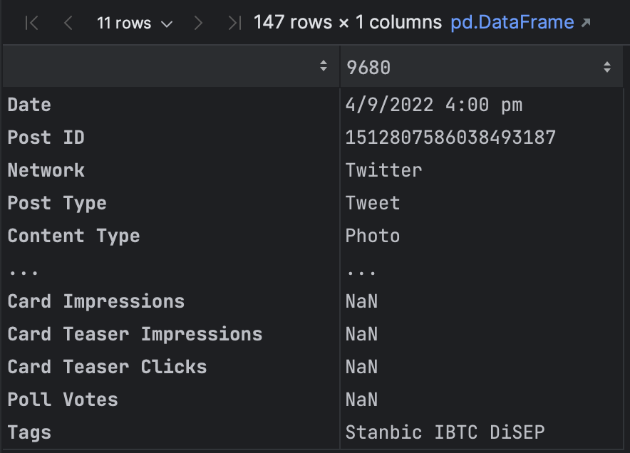
Data Preparation – Sample Record
Each record had a feature stating:
The social media network they originated from.
The date and time the Post was sent.
The type of content they were, the text of the Post.
The name of the sender of the post.
General and specific social media metrics collected by the network.
Please see the jupyter notebook for more information.

Slide 9
Data Preparation – Data Cleaning Strategy
Empty rows & duplicate rows were removed.
The date feature was cleaned and converted to datetime type.
New columns for hashtags, post word counts, character counts, and sentiments were added.
Each column was converted to its appropriate datatype
Datatypes to be changed
More than 30 columns were removed because they contained no data.
The data in ‘Potential Reach’ which represented ‘Reach’ data from Twitter was moved to the ‘Reach’ column.
Impute missing values for numeric and categorical features.
Set Date as Index.
Please see the jupyter notebook for more information.

Slide 10
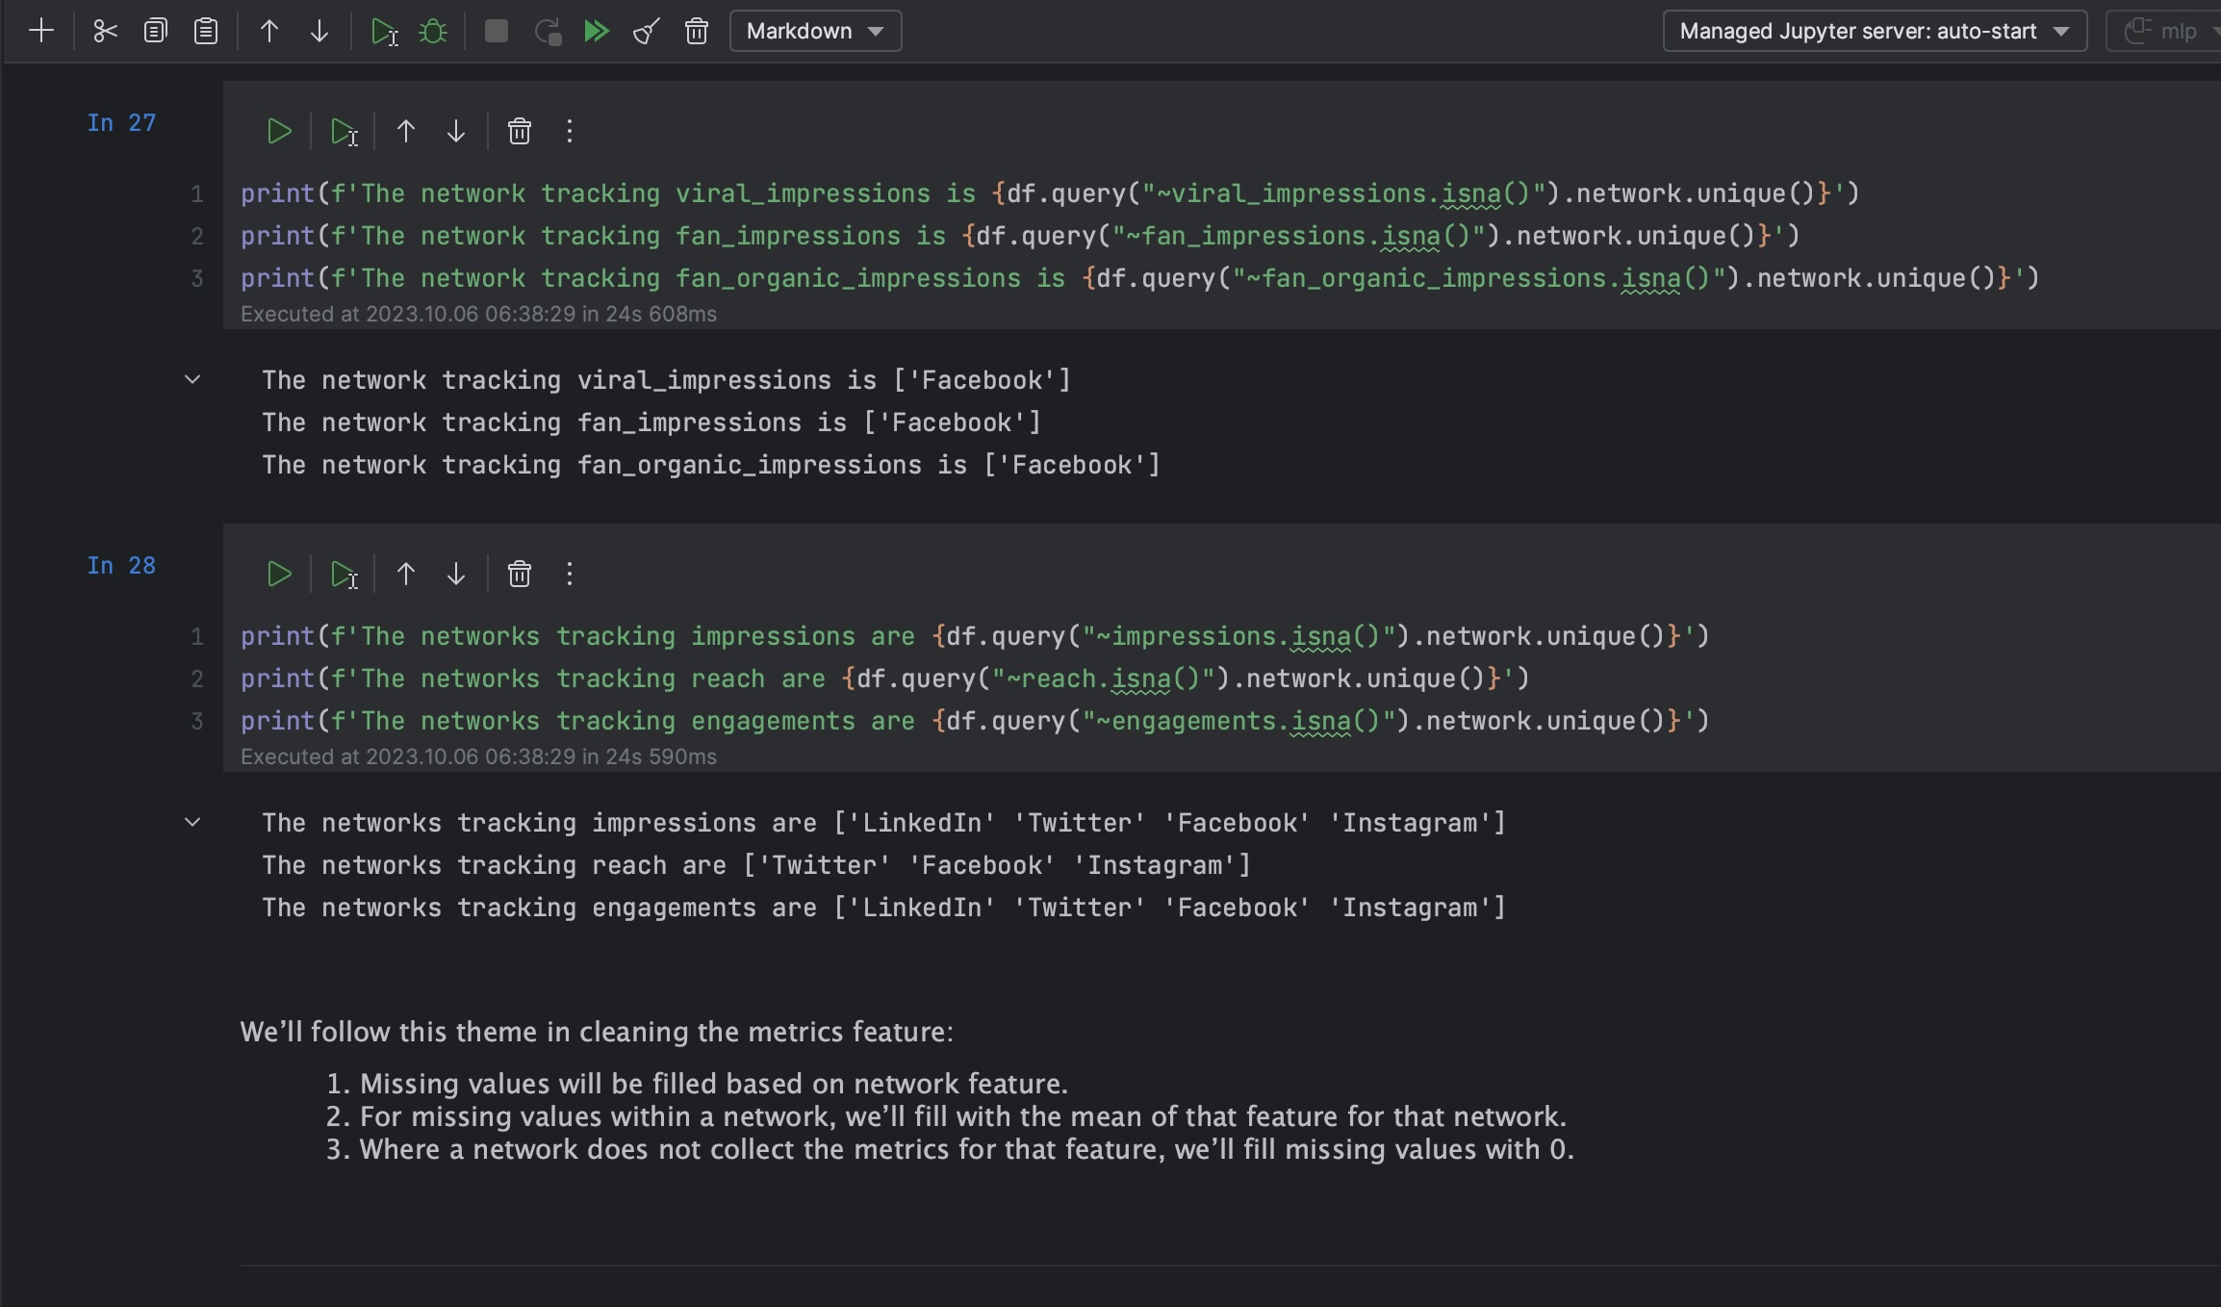
Data Preparation – Data Imputation Strategy
There are certain metrics that are network-specific, i.e., tracked and collected by only certain networks.
Our data imputation strategy for missing values is:
Where the metric is collected by a social media network, missing values will be imputed using the average of that metric filtered by the relevant social network.
Where the metric is not collected by a social network, missing values will be imputed using zero, representing that the metric is not collected by the social media network.
For categorical or text-based features, missing values were imputed using text stating that no value was provided for the record.
Please see the jupyter notebook for more information.

Slide 11
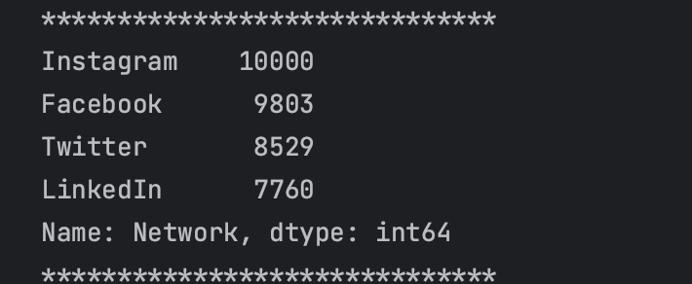
Data Preparation – Summary of the Dataset
The dataset has 36,092 rows.
There are 3 categorical features, 4 text-based features and 105 numeric features.
There are 4 distinct networks, 7 distinct content types and 12 distinct senders in the dataset.
The dataset has date records spanning the 11-year period ranging from 2013 to 2023
Please see the jupyter notebook for more information.

Slide 12
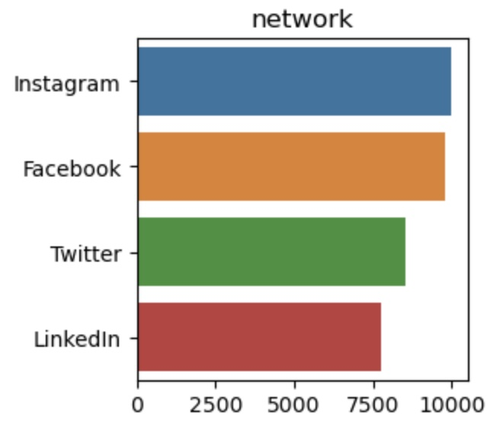
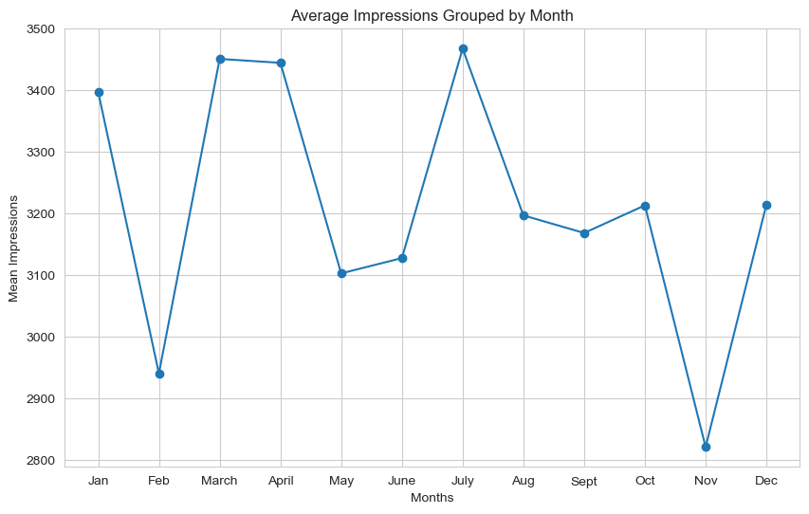
Exploratory Data Analysis with Visualization
We visualized the relationship between a few variables in the dataset to determine:
If variables are correlated.
How categorical variables are distributed over numeric metrics.
What trends over time are evident in variables
We visualized variable distributions to make assumptions for statistical analyses.
We used word clouds to visualize hashtags to understand what posts are talking about.
Please see the jupyter notebook for more information.
Example - Bar Chart Spread of Social Media Networks
Example – Line Chart of Monthly Impressions

Slide 13
Exploratory Data Analysis with Visualization
We conducted exploratory data analysis to determine:
What posts are talking about.
What kind of posts are popular.
What are the most engaging types of posts.
Which platform yields the highest engagement for the client.
What are the peak times for user engagement.
What are the noticeable trends over time (e.g., increasing likes, decreasing shares).
What are the sentiments of posts and how does it affect engagement.
Please see the jupyter notebook for more information.

Slide 14
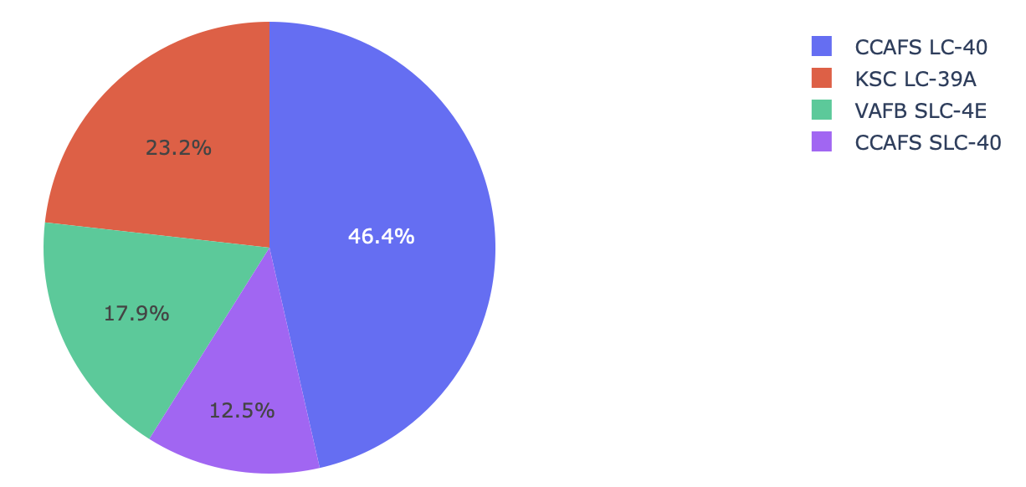
Build a Dashboard with Tableau
All Launch Site Successes
We built an interactive dashboard with Plotly dash.
We plotted pie charts showing the total launches by selected sites.
We plotted a scatter chart showing the relationship between Outcome and Payload Mass for different booster versions.
GitHub URL – SpaceX Dash App Script

Slide 15
Statistical Analysis
Plot the data
Determine the hypothesis
Test the hypothesis
Make conclusions.
We conducted statistical analysis to test the following hypotheses:
Whether the relationships between features are statistically significant.
Whether the strength and direction of the relationship between variables is statistically significant.
Whether there is a significant difference between 2 groups or variables.
Please see the jupyter notebook for more information.

Slide 16
Insight Generation
Insights from Exploratory Analysis
Insights from Statistical Analysis
Insights summarized by Interactive Dashboard

Slide 17
Section 2 Insights Drawn From Exploratory Analysis

Slide 18
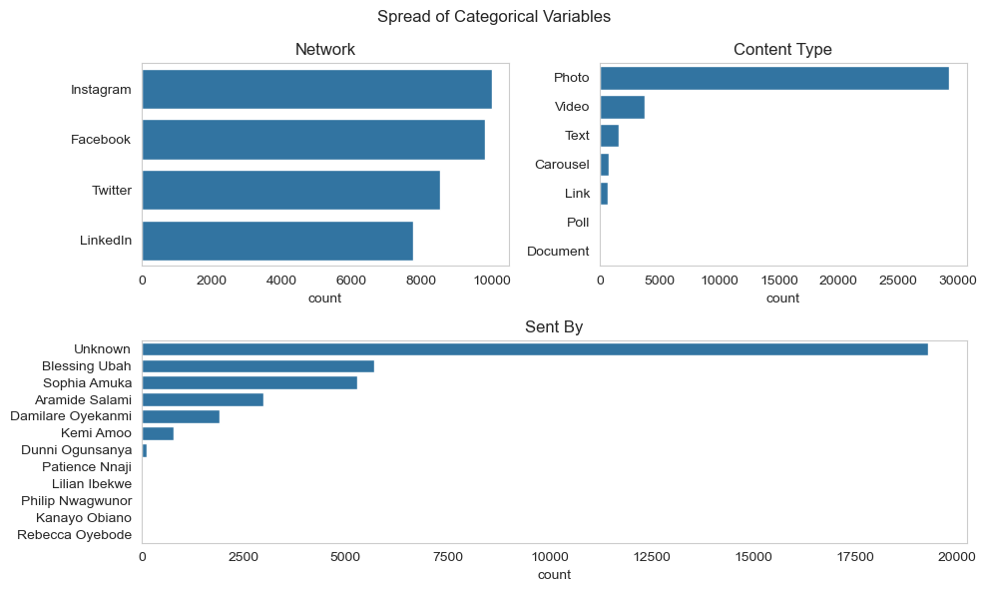
Categorical Features
There are 3 categorical variables: Network, Content Type & Sent by.
From Network, Instagram has the highest number of records in the dataset and LinkedIn has the least.
From Content Type, Photo is the feature with the most number of records and Document is the feature with the least.
Most posts are sent by an unknown sender, but from known senders, Blessing Ubah has the highest number of posts.
Please see the jupyter notebook for more information.

Slide 19
Categorical Features - Network
The 3 main engagement metrics are Impressions, Reach & Engagements.
Impressions is the total number of times a piece of content is displayed on a user's screen.
Reach refers to the unique number of users who have seen a piece of content at least once during a specific reporting.
Engagements encompass various types of interactions that users have with a piece of social media content.
Please see the jupyter notebook for more information.

Slide 20
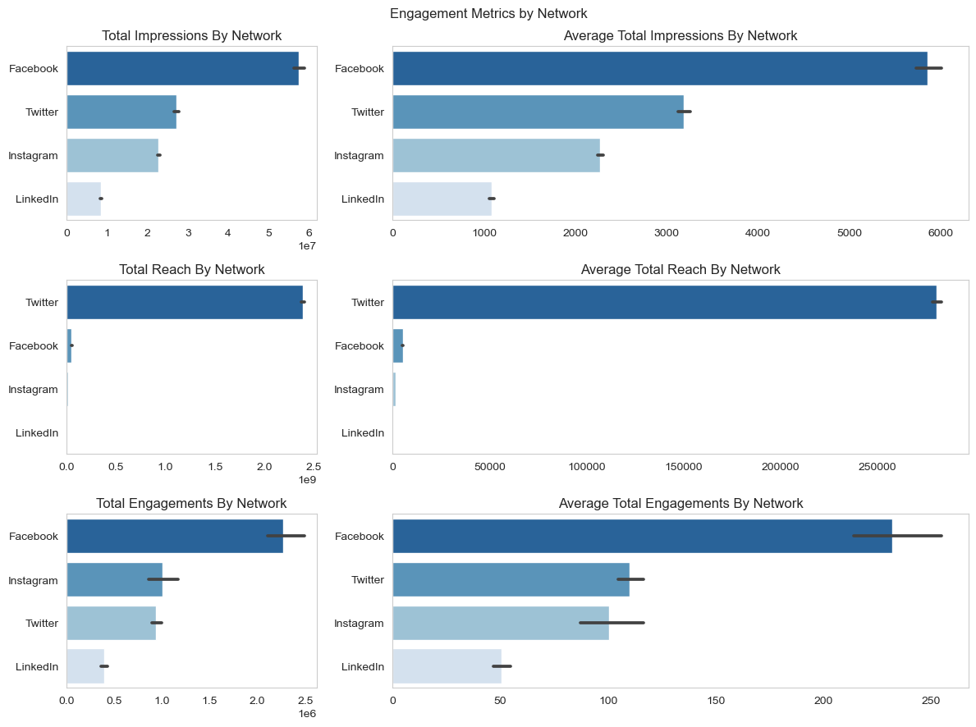
Categorical Features - Network
Facebook is the network with the highest number of impressions, nearly twice the number of the second highest, Twitter
Twitter has the highest Reach. This is likely because Twitter track Reach as Potential Reach, which is likely wider than actual reach.
LinkedIn does not track Reach or any equivalent metric.
Facebook has the highest number of engagements.
Please see the jupyter notebook for more information.

Slide 21
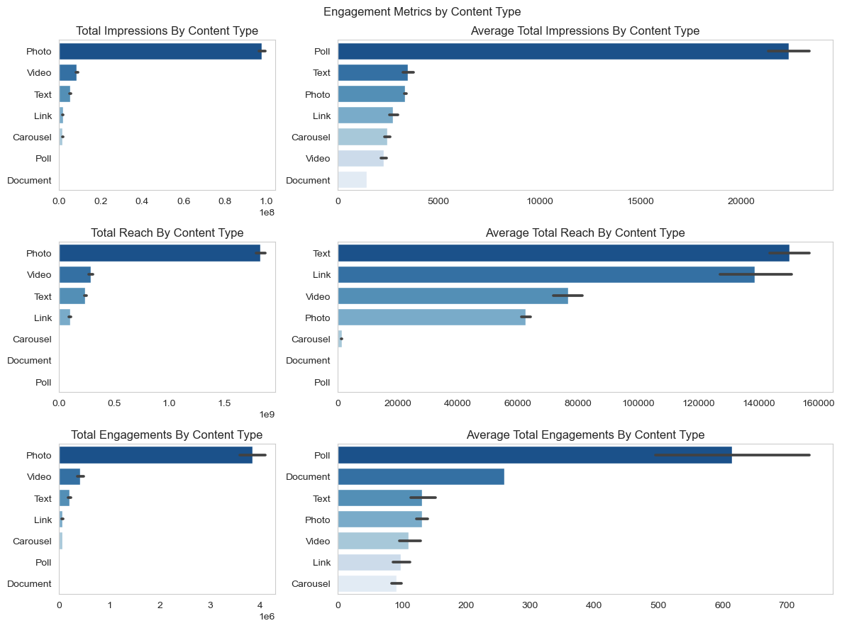
Categorical Features – Content Type
Photo posts have the highest total engagement metrics.
On average, Polls have the highest impressions and engagements. However, there are only 2 poll records in the dataset.
On average, text posts have the highest reach.
Please see the jupyter notebook for more information.

Slide 22
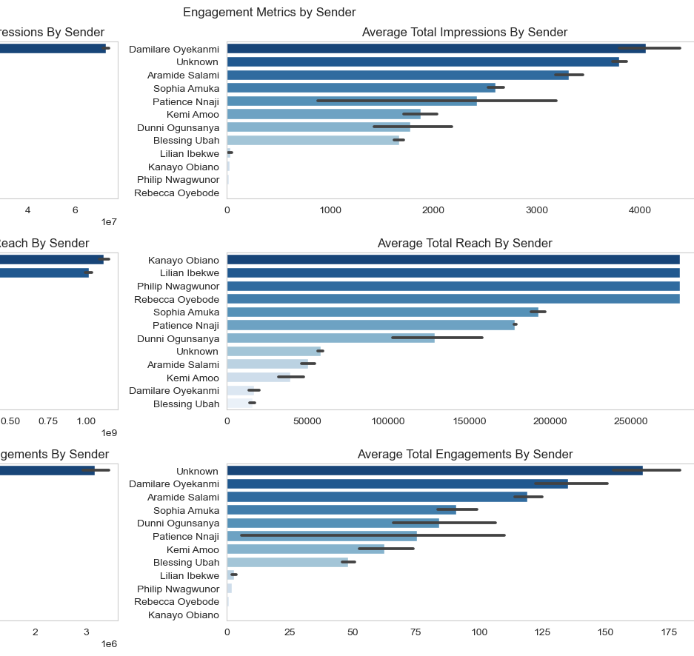
Categorical Features – Sender
The highest total values for all metrics is held by the Unknown poster.
On average, the highest impressions are from posts sent by Damilare Oyekanmi.
The average highest reaches are from posts sent by Kanayo Obiano, Lilian Ibekwe, Philip Nwagwunor and Rebecca Oyebode.
The posts with the highest engagements on average are from the unknown poster, with Damilare Oyekanmi coming in second.
Please see the jupyter notebook for more information.

Slide 23

Text-Based Features
There are 4 text-based features: post, linked content, tags and hashtags.
We used hashtags to determine what subjects the posts are talking about.
The most frequent hashtag is #ITCANBE
Please see the jupyter notebook for more information.

Slide 24

Numerical Features – Social Media Metrics
There are 9 types of numeric features / metrics collected in the dataset:
General metrics (collected by at least 3 of the 4 networks)
Impression metrics
Reach Metrics
Engagement Metrics
Reaction metrics
Activity metrics
Click metrics
User-based metrics
Video metrics
Please see the jupyter notebook for more information.

Slide 25
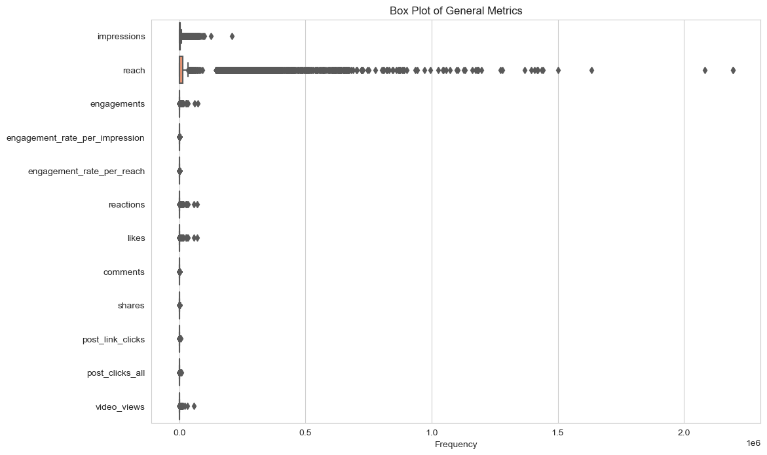
General Metrics
There are 12 general metrics:
Impressions
Reach
Engagements
Engagement rate per impression
Engagement rate per reach
Reactions
Likes
Comments
Shares
Link clicks
All clicks
Video views
This classification will be used for the statistical analysis section.
Please see the jupyter notebook for more information.

Slide 26
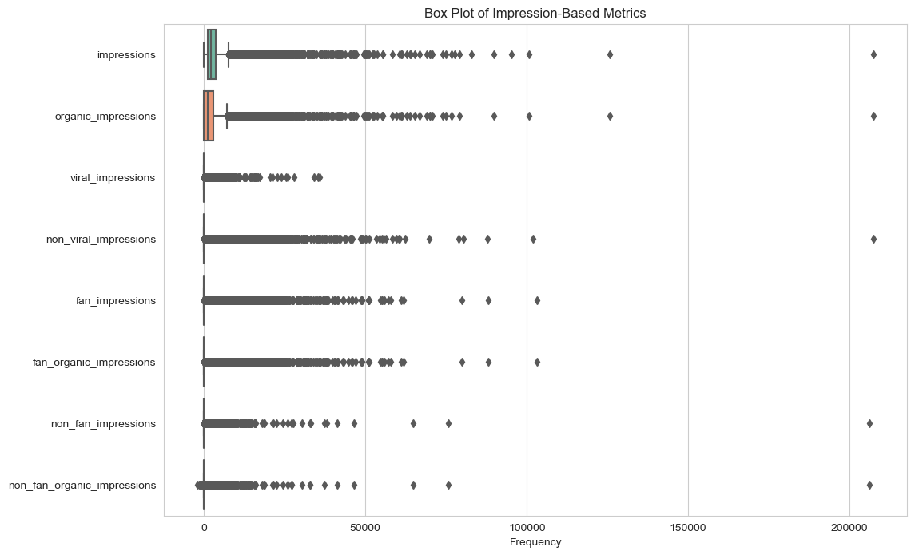
Impression Metrics
There are 8 impression metrics:
Impressions
Organic impressions
Viral impressions
Non-viral impressions
Fan impressions
Fan organic impressions
Non-fan impressions
Non-fan organic impressions
Beyond impressions and organic impressions, other impression metrics are only collected by Facebook.
Please see the jupyter notebook for more information.

Slide 27
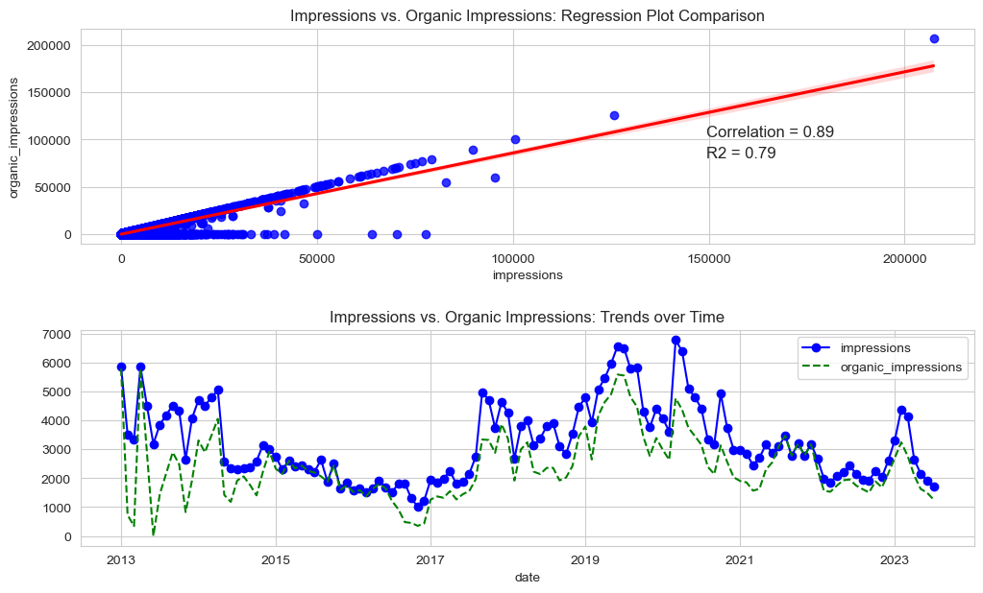
Impression Metrics – Impression vs. Organic Impressions
Organic impressions are impressions generated without any paid promotion or advertising.
Impressions and organic impressions are nearly identical.
This implies that nearly all impressions are organic.
The values on the zero axis represent impressions from Twitter, which does not collect organic impressions data.
Trend data shows that organic impressions are consistently lower than actual impressions, reflecting missing data from Twitter. However, the trend is identical.
Please see the jupyter notebook for more information.

Slide 28
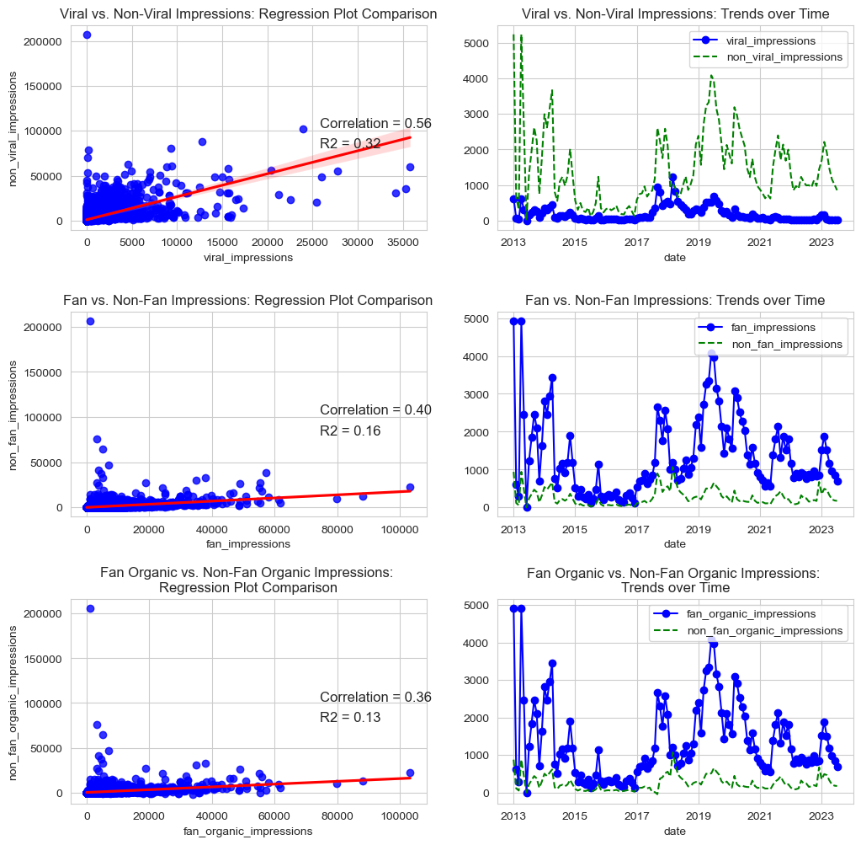
Impression Metrics – Other Impressions
Fan impressions are from users who have liked or followed a Facebook Page (fans) and and non-fan impressions are from those who have not (non-fans).
Viral impressions are from content that spread rapidly and widely across Facebook. Non-viral impressions are those from the limited audience of the poster’s fan or followership.
From the regression plots, there is some correlation between each metric and its opposite.
The trend charts show that a significant amount of the poster’s impressions are from its fans and followers.
Please see the jupyter notebook for more information.

Slide 29
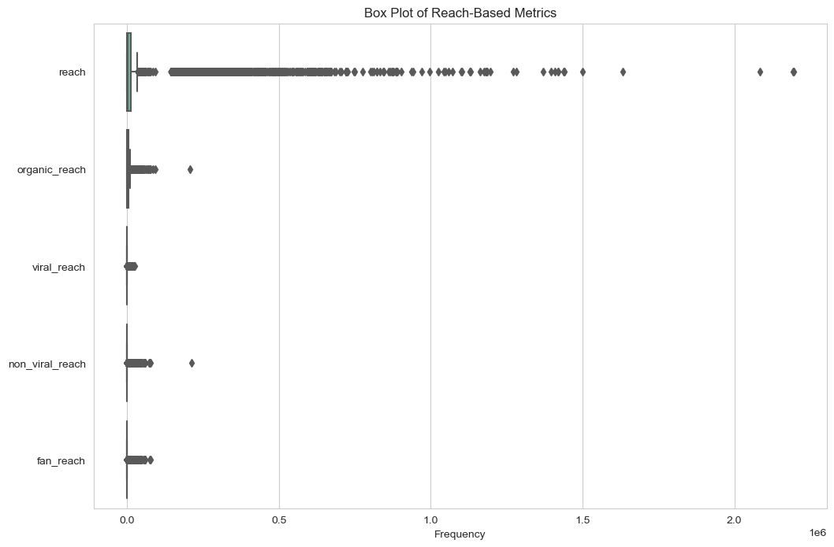
Reach Metrics
There are 5 reach metrics:
Reach
Organic reach
Viral reach
Non-viral reach
Fan reach
Beyond reach and organic reach, other reach metrics are only collected by Facebook.
Please see the jupyter notebook for more information.

Slide 30
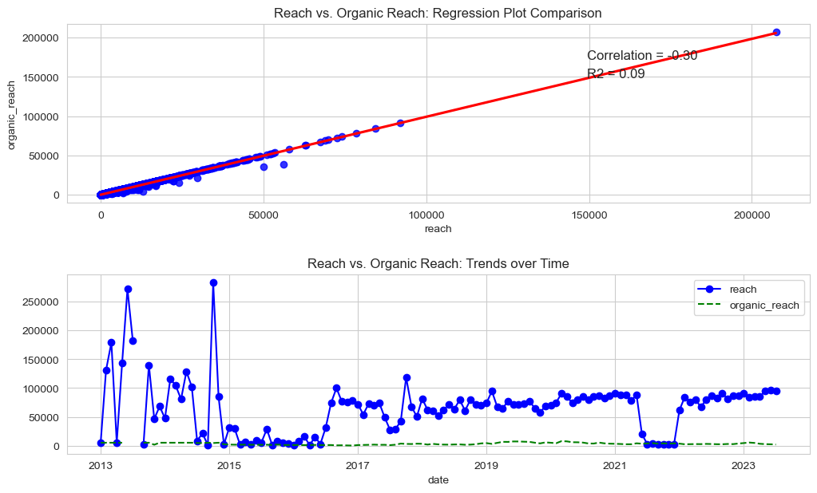
Reach Metrics – Reach vs. Organic Reach
Organic reach refers to the number of unique users who have seen a piece of content through unpaid means.
Reach and organic reach are nearly identical.
This implies that nearly all reach is organic.
There are no reach nor organic reach data attributable to LinkedIn.
Reach has significantly larger values than organic reach due to the large values from Twitter’s potential reach.
Trend data shows that organic reach is consistently lower than actual reach, reflecting missing data from Twitter.
Please see the jupyter notebook for more information.

Slide 31
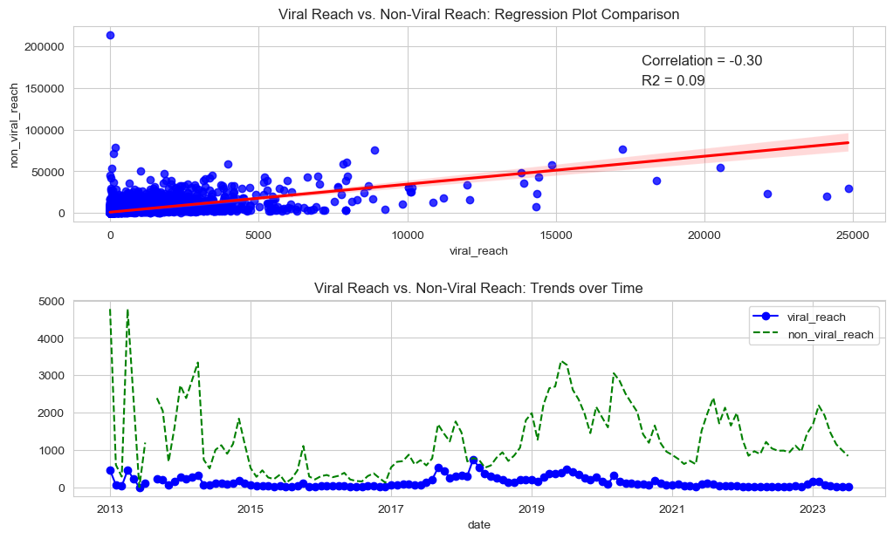
Reach Metrics – Other Reach
Viral reach indicating that a piece of content has gone viral and reached a wide audience, while non-viral reach pertains to content that has not achieved viral status.
Fan reach occurs when content is seen by users who have already liked or followed a specific Facebook Page (fans).
The trend charts show that a significant amount of the poster’s reach are from its fans and followers.
Please see the jupyter notebook for more information.

Slide 32
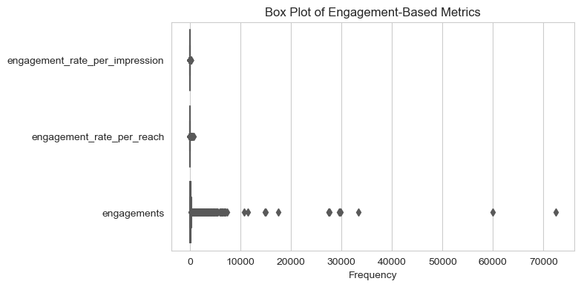
Engagement Metrics
There are 3 engagement metrics:
Engagements
Engagement per impression
Engagement per reach
Please see the jupyter notebook for more information.

Slide 33
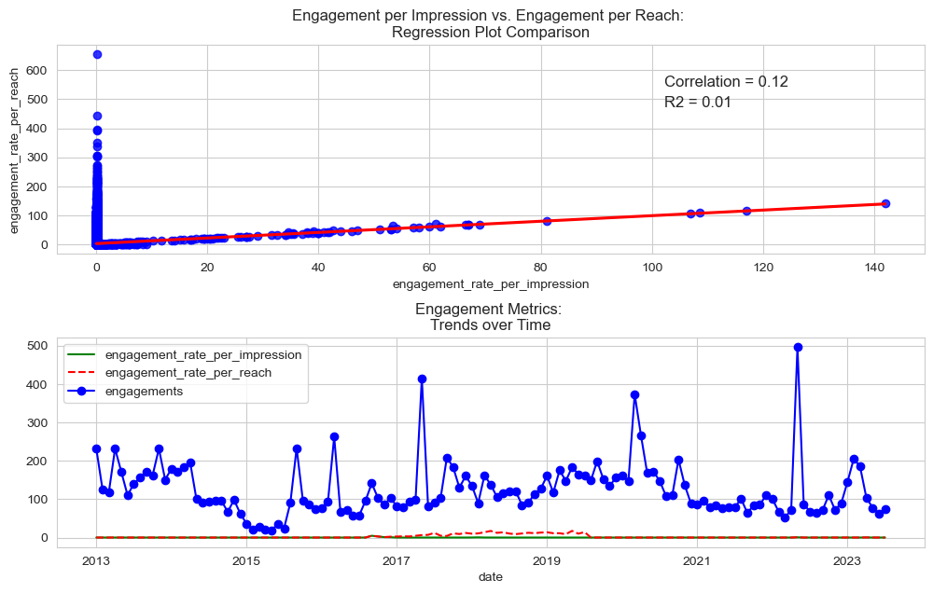
Engagement Metrics
Engagement per impressions and engagement per reach reflect the ratio of engagement and impressions/ reach.
Please see the jupyter notebook for more information.

Slide 34
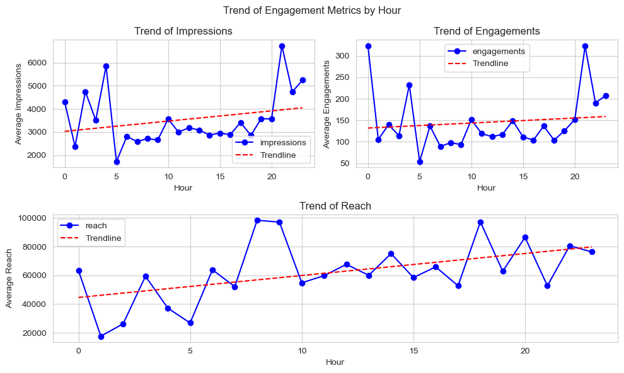
Engagement Metrics by Hour
When aggregated by Hour, engagements see an upward trend as the day progresses across all engagement metrics.
9pm is the Hour for peak impressions and engagements on average.
8am and 6pm are the hours of peak reach on average.
Please see the jupyter notebook for more information.

Slide 35
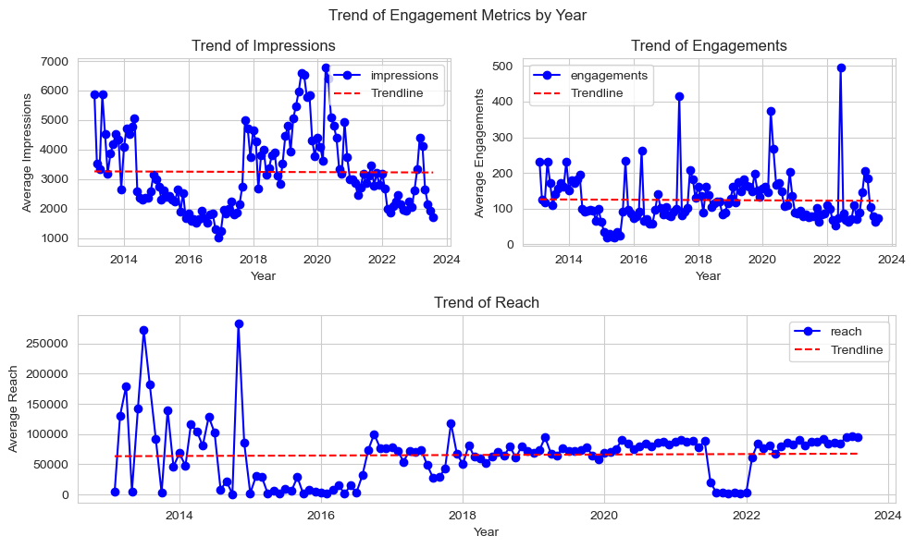
Engagement Metrics by Year
When aggregated by Year, engagements are flat across all engagement metrics.
2020 is the year for peak impressions on average.
2022 is the year for peak engagements on average.
2015 is the year of peak reach on average.
Please see the jupyter notebook for more information.

Slide 36
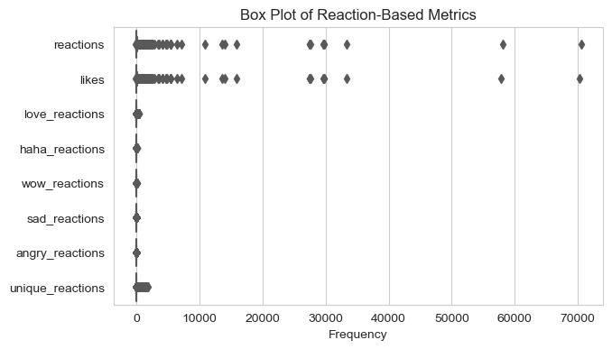
Reaction Metrics
Reaction metrics provide insights into how users are responding to posted content. There are 8 reaction metrics:
Reactions
Likes
Love reactions
Haha reactions
Wow reactions
Sad reactions
Angry reactions
Unique reactions
Beyond reactions and likes, other reaction metrics are only collected by Facebook.
Please see the jupyter notebook for more information.

Slide 37
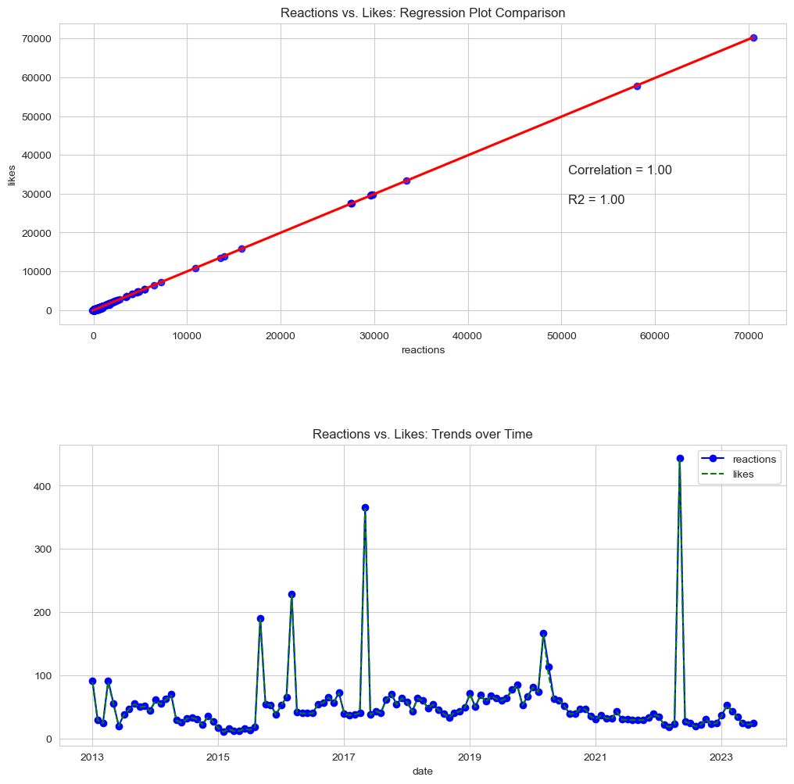
Reaction Metrics – Reactions vs. Likes
Users use likes to express positive reaction to a post. Reactions allow users to express a wider range of engagement a range of emotions in response to content.
In our dataset, reactions and likes are identical.
Please see the jupyter notebook for more information.

Slide 38
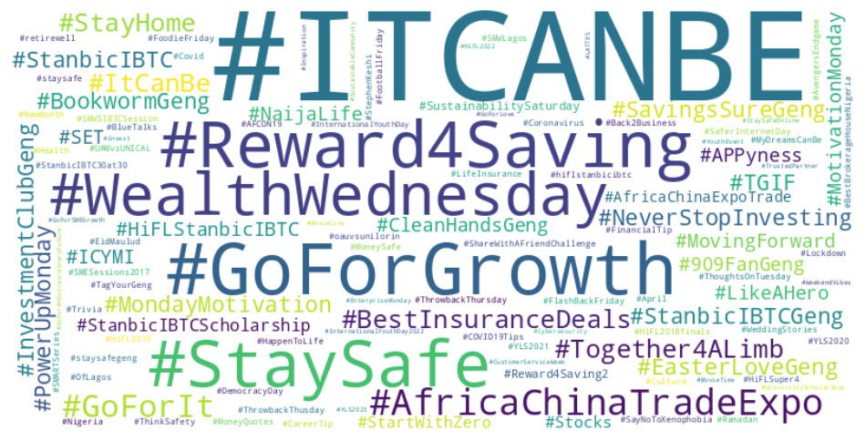
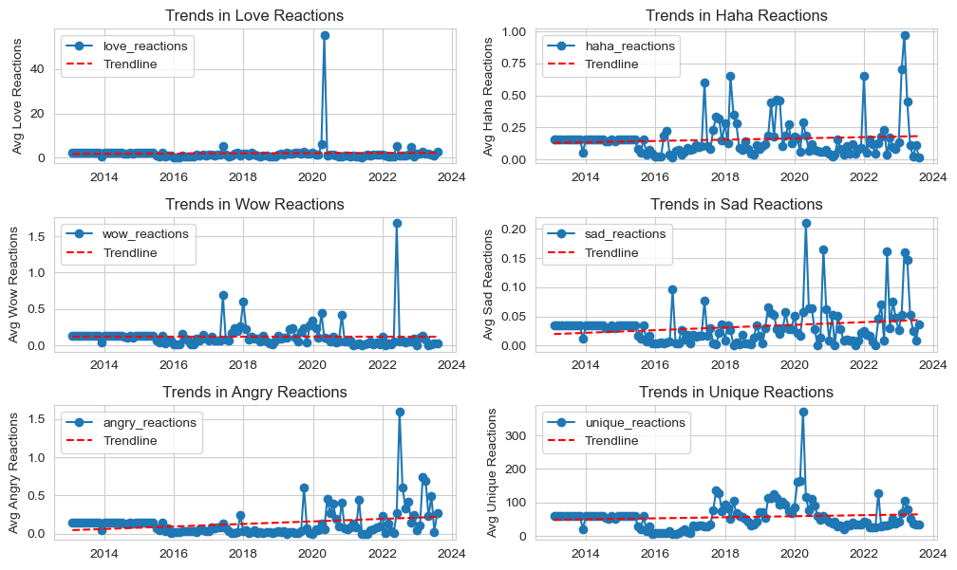
Reaction Metrics – Other Reactions
Apart from love and wow reactions, other reaction metrics have seen an increase in values over time.
Given the relationship between reactions and engagements, this may imply that the poster’s followers have become more engaging.
The highest trend increases are from sad and angry reactions. When compared to the word cloud of hashtags from posts with sad reactions greater than the trendline, the cause of this increase is unclear.
Please see the jupyter notebook for more information.

Slide 39
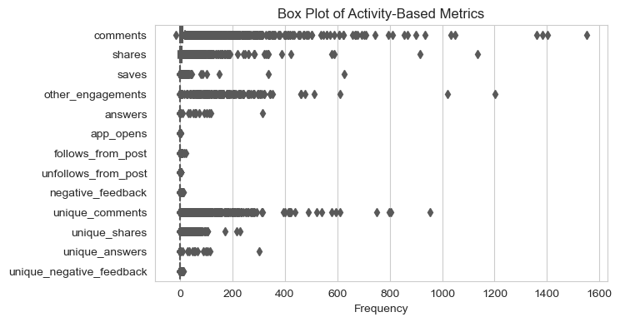
Activity Metrics
There are 13 activity metrics. Comments is the only metric common to all and shares is collected by all but Instagram.
Segmented by network, the activity metrics are:
Facebook – answers, negative feedback, unique comments, unique shares, unique answers, & unique negative feedback.
Twitter – other engagements, app opens, follows from post, & unfollows from post.
Instagram – saves.
Please see the jupyter notebook for more information.

Slide 40
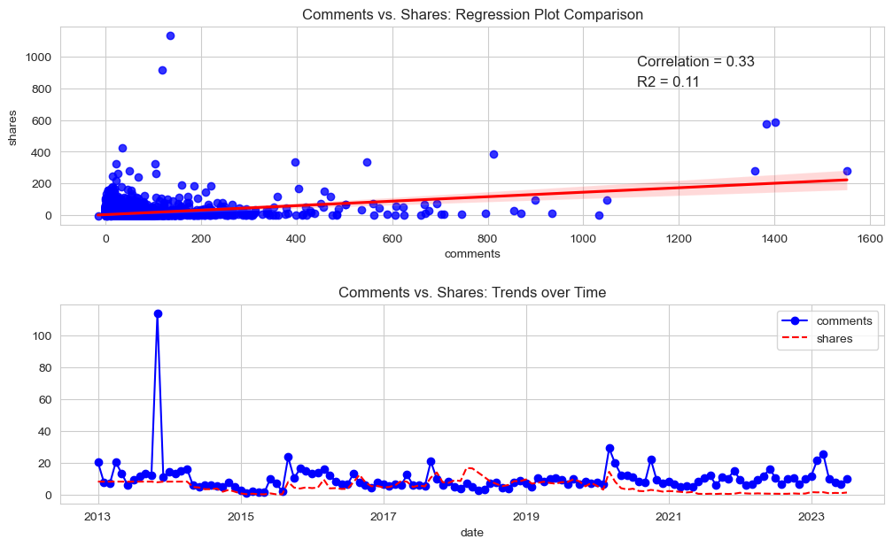
Activity Metrics – Comments & Shares
Comments & shares are slightly correlated. The extension along the 0-axis may represent values from Instagram which does not collect shares data.
The trend of comments and shares are similar, however posts on average have more comments than shares.
Please see the jupyter notebook for more information.

Slide 41
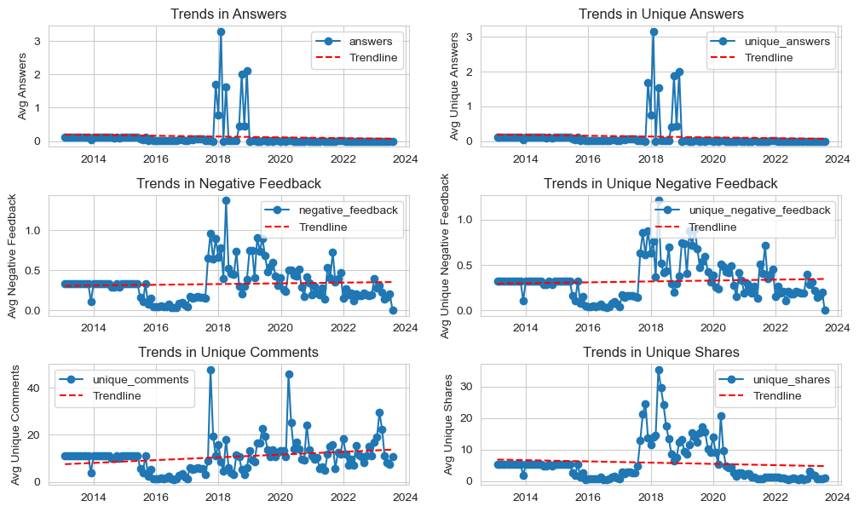
Activity Metrics – Facebook
Trend in answers is on a decline while trends in negative feedback is on the rise.
Unique comments are also rising while unique shares are declining.
While we can’t determine the cause of this from hashtags, senders or content types, we can see from all charts that there is a significant increase in metric values from 2018 that starts to fall around 2020-2021.
This may be the result of changing algorithms and user patterns.
Please see the jupyter notebook for more information.

Slide 42
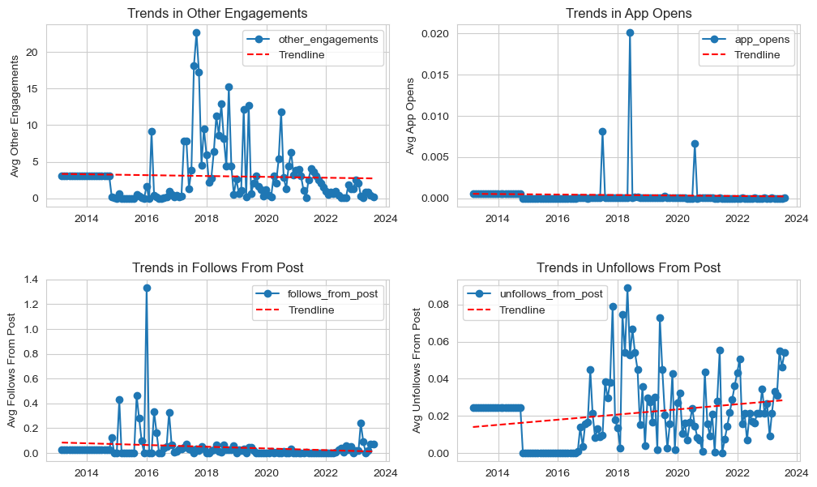
Activity Metrics – Twitter
Trends from all twitter activity metrics are on the decline except unfollows from post which is on the incline.
This is likely due to changing user behaviour on the platform.
While we can’t determine the cause of this from hashtags, senders or content types, we can see from all charts that there is a significant increase in metric values from 2018 that starts to fall around 2020-2021.
This may be the result of changing algorithms and user patterns.
Please see the jupyter notebook for more information.

Slide 43
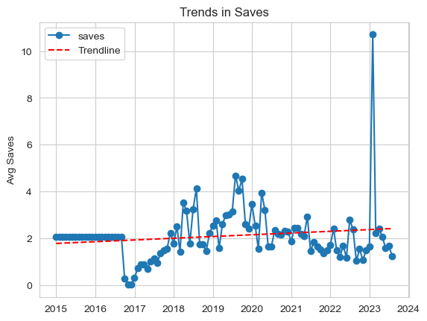
Activity Metrics – Instagram
Instagram saves are on the increase on the average despite a decline from the upward trend peak in 2019.
Please see the jupyter notebook for more information.

Slide 44
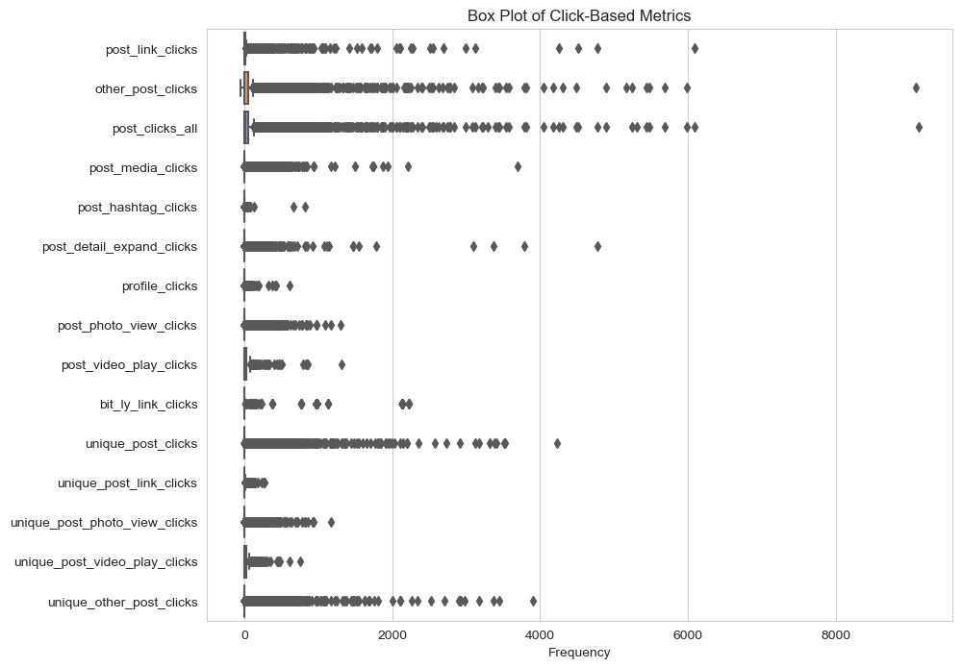
Click Metrics
There are 15 click metrics. Instagram does not collect any click metrics. Of the remaining network, link clicks and all clicks are tracked by all of them.
Segmented by network, the click metrics are:
Facebook – other post clicks, post photo view clicks, post video play clicks, unique post clicks, unique post link clicks, unique post photo view clicks, unique post video play clicks & unique other post clicks.
Twitter – other post clicks, post media clicks, post hashtag clicks, post detail expand clicks, profile clicks & bit.ly link clicks.
Please see the jupyter notebook for more information.

Slide 45
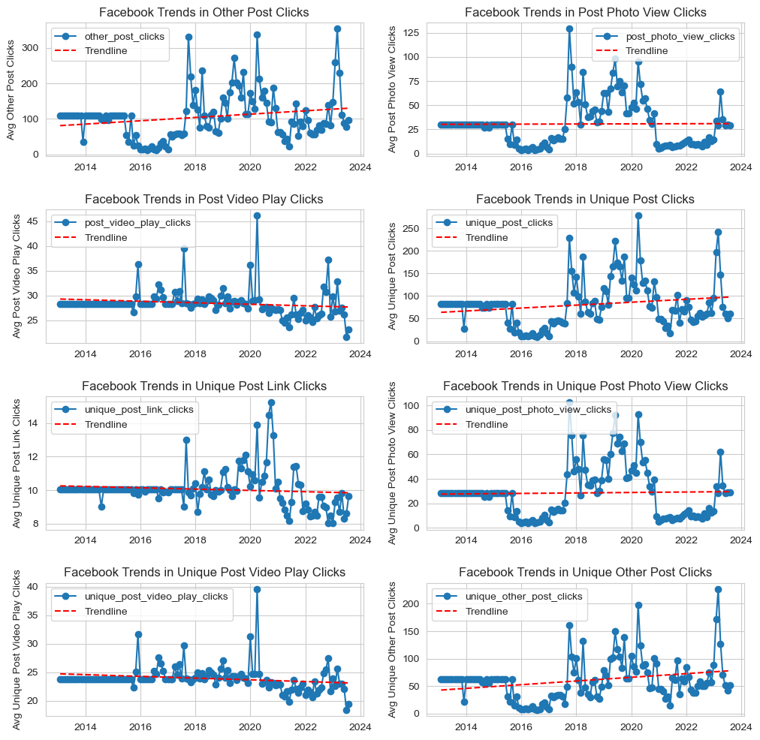
Click Metrics – Facebook
The trend for clicks on posts (possibly to read more) is on the rise, but the trend for link and video post clicks are on the decline.
This may be because the poster’s Facebook fans either prefer text posts to video / link posts and/ or text posts are cheaper on user data than other posts.
The poster must have a posting strategy for each social media network that includes how its user base engages with the platform.
Please see the jupyter notebook for more information.

Slide 46
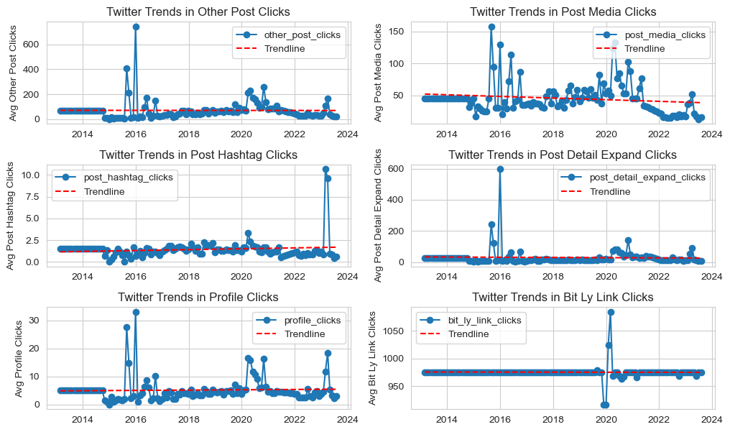
Click Metrics – Twitter
Most twitter click trends are flat.
Media clicks trend is on the decline, facing a sharp decline from 2021.
Hashtag clicks is trending slightly upward, which is line with how users use Twitter.
Please see the jupyter notebook for more information.

Slide 47
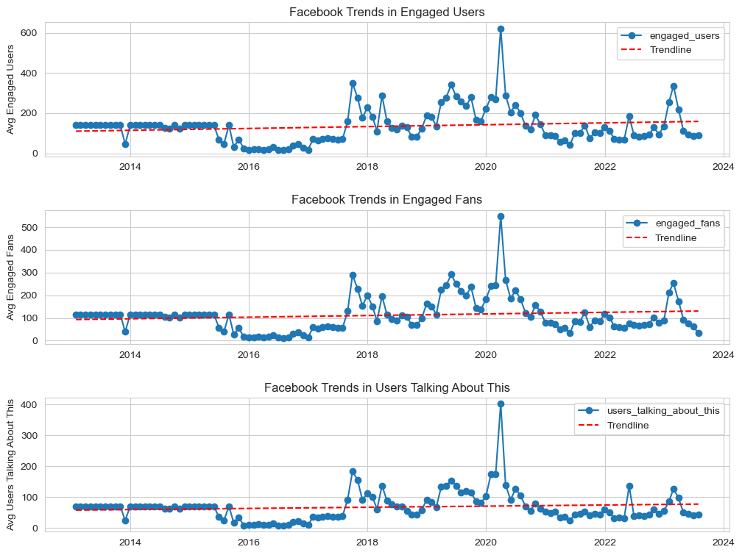
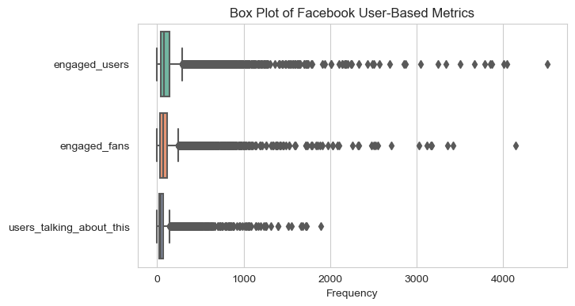
User-Based Metrics
User based metrics are only tracked by Facebook.
All these metrics are on an upward trajectory, implying that the poster’s followers are increasingly engaging with the content on its page.
Across all metrics, there is a significant spike in values between 2018 and 2020. This reflects a trend across many other metrics.

Slide 48
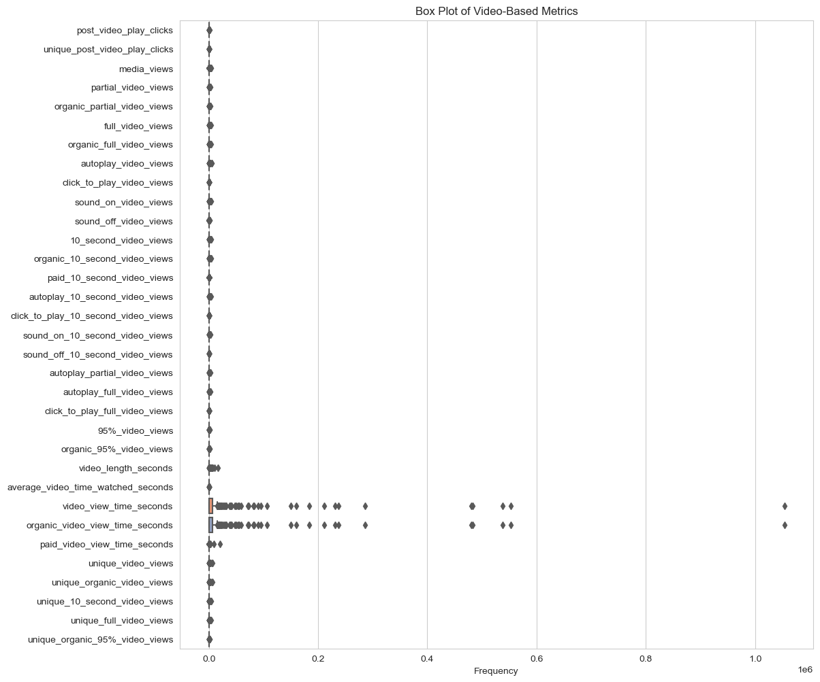
There are 32 video metrics all of which are tracked by Facebook except media views, which is only tracked by Twitter.
Video Metrics

Slide 49
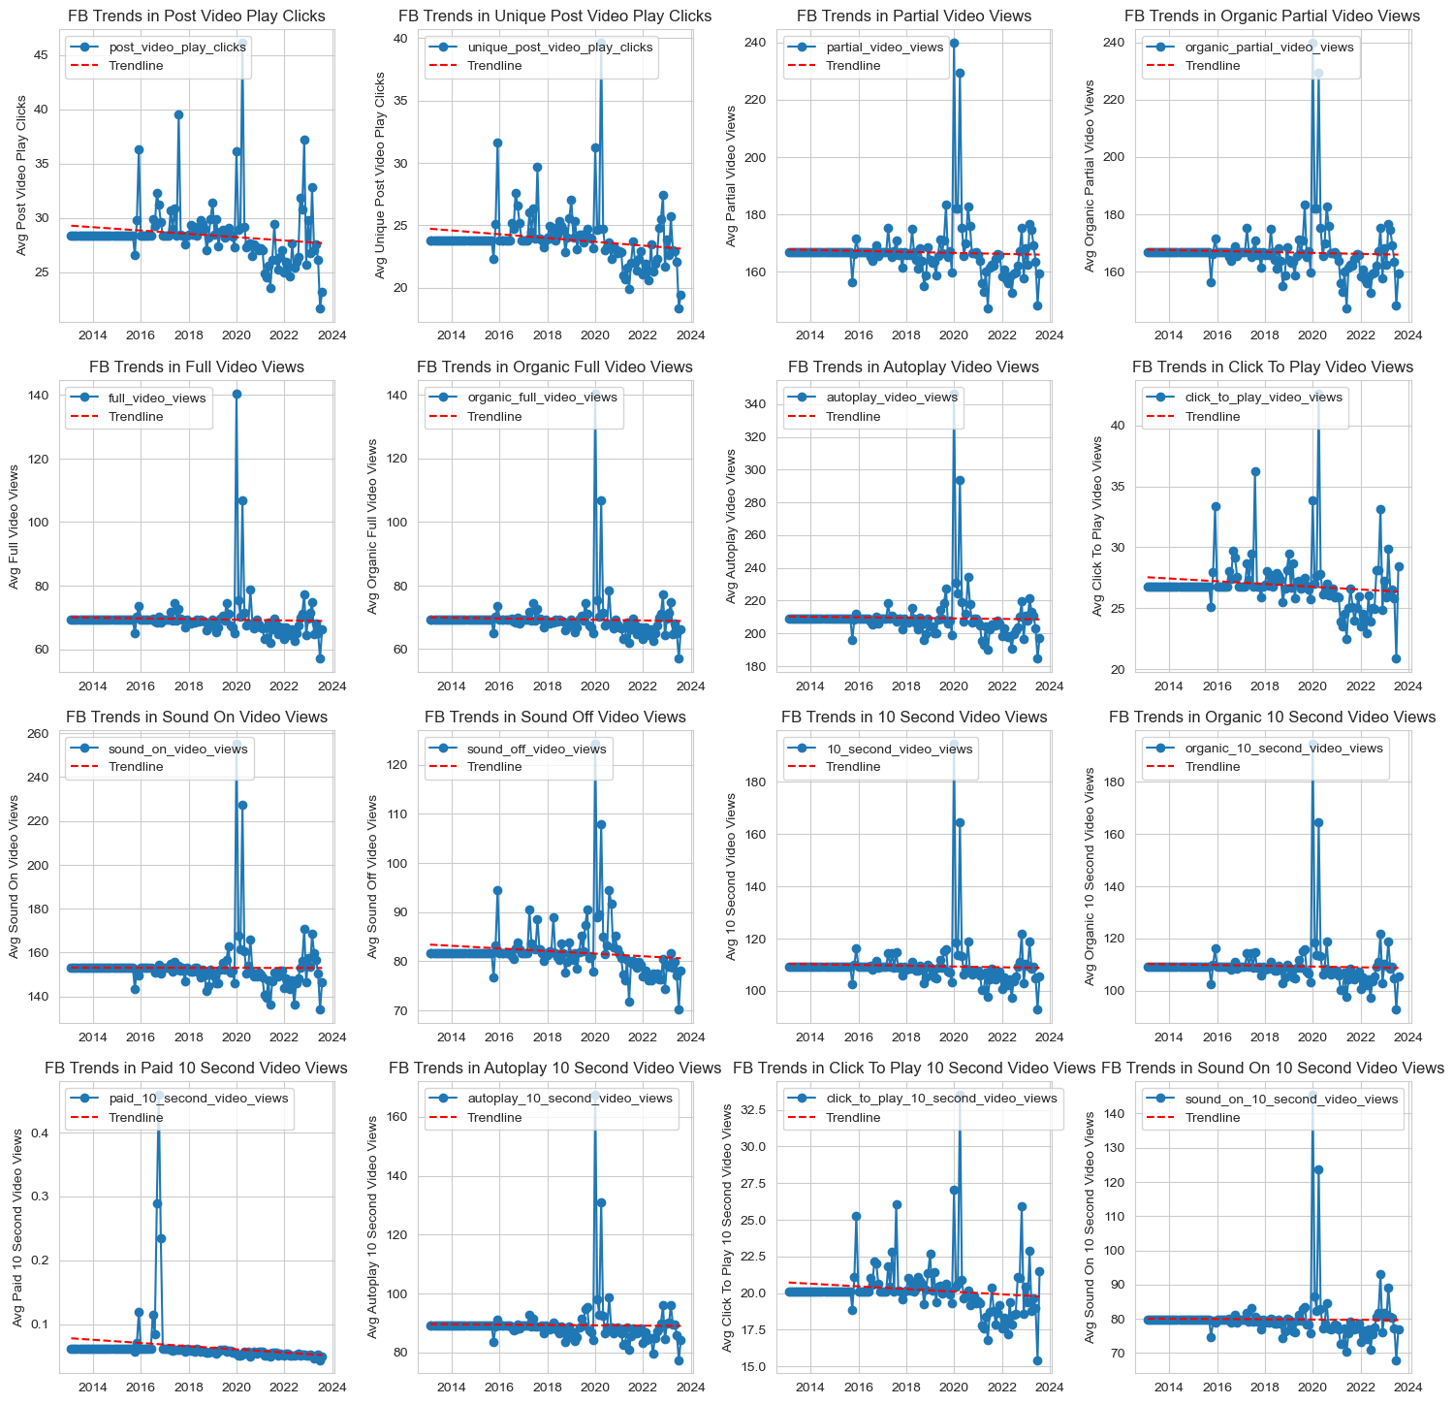
Video Metrics – Facebook
All Facebook video metrics are either flat or trending downward.
This confirms the trend we saw in clicks about video which has seen a sharp decline.
Please see the jupyter notebook for more information.

Slide 50
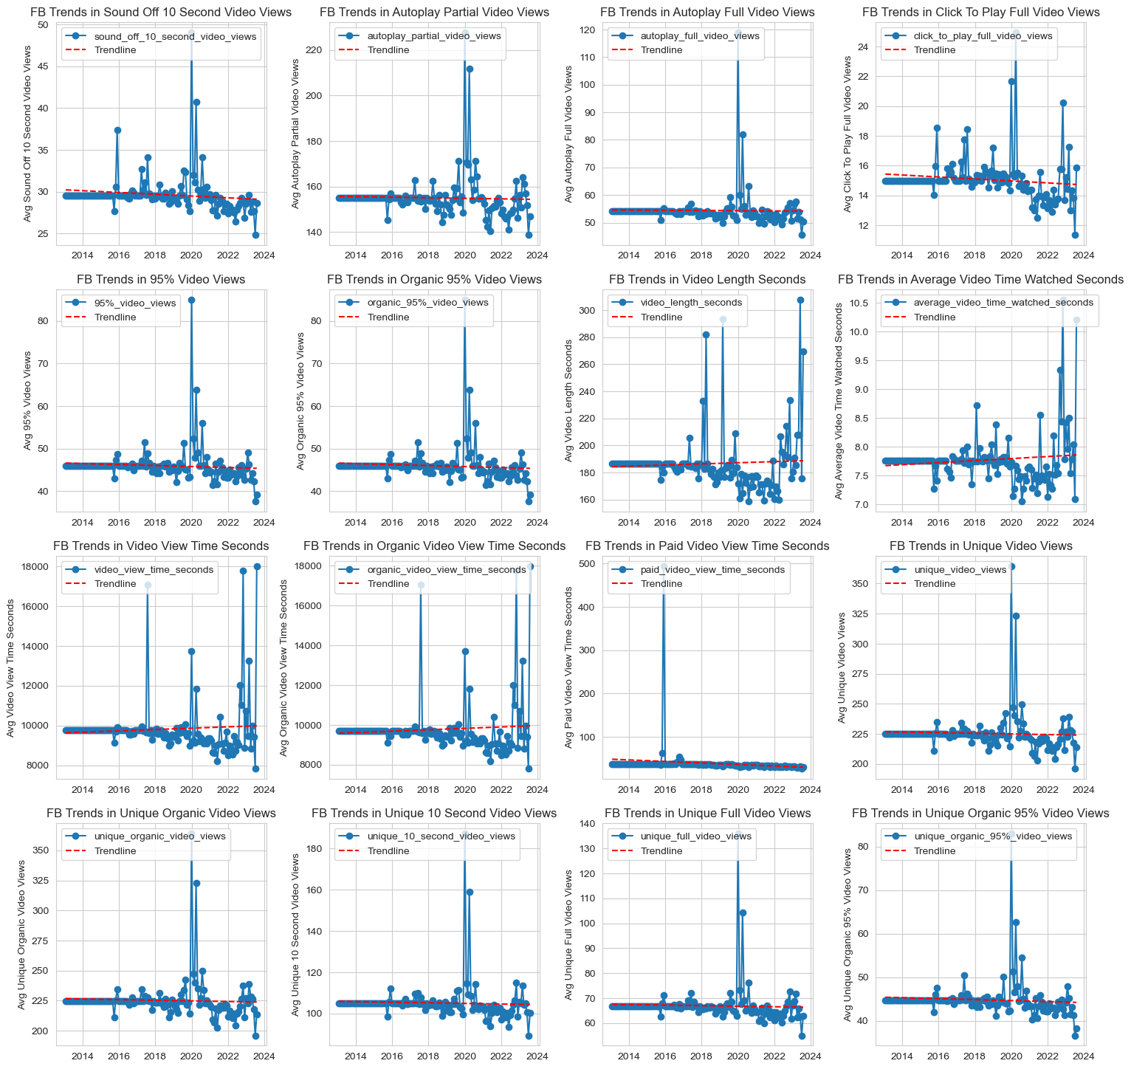
Video Metrics – Facebook 2
All Facebook video metrics are either flat or trending downward.
This confirms the trend we saw in clicks about video which has seen a sharp decline.
Please see the jupyter notebook for more information.

Slide 51
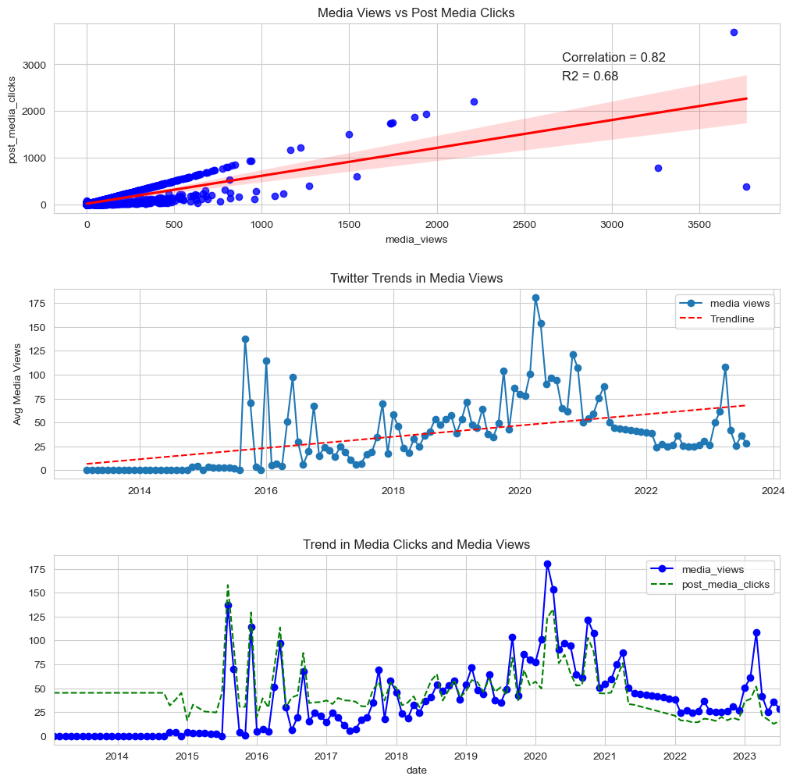
Video Metrics – Twitter
Twitter media view trends are on the upward incline. This is contrasted with post media clicks which are on the decline.
Media clicks and media views are positively correlated yet move in negative direction over time.
The trendlines for both metrics are similar but there is a slight downtrend in media clicks trend.
Please see the jupyter notebook for more information.

Slide 52
Section 3 Key Questions Addressed in Exploratory Analysis

Slide 53
Are Impressions Seasonal?
When grouped by months, Impressions seem to be on an upward trend between November and April (the dry months in Nigeria’s seasonal calendar), with the exception of a dip in February.
The lowest months for impressions are the months between May and November (the wet months in Nigeria’s seasonal calendar), with exception of a peak in July.
This implies that impressions are seasonal.
Please see the jupyter notebook for more information.

Slide 54
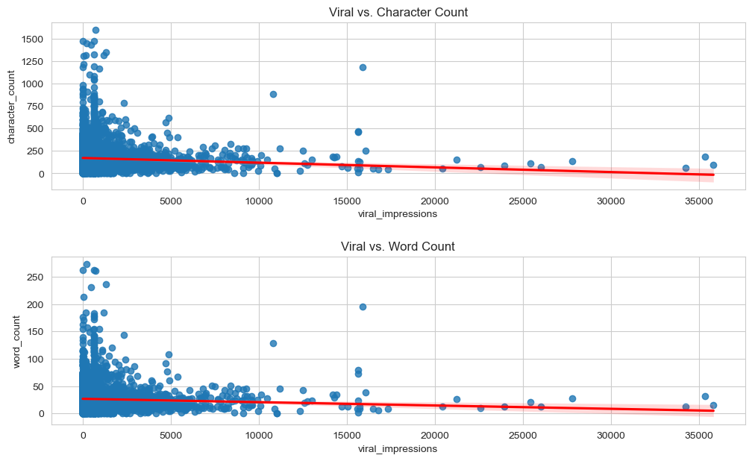
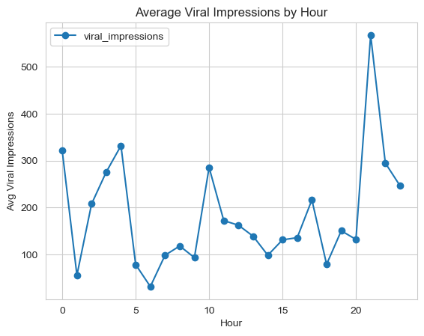
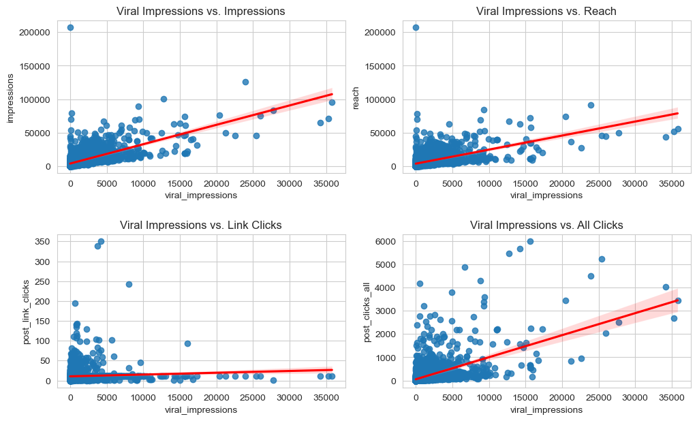
What trends favor virality?
Virality is not strongly correlated with word or character counts.
On average the most viral posts are those made around 9pm.
Impressions, reach and all clicks are positively correlated with virality. However, this does not tell us which variable is dependent on the other.
Expanding impressions, reach and posting interesting content during evening time generally seems to positively favour virality.
Please see the jupyter notebook for more information.

Slide 55
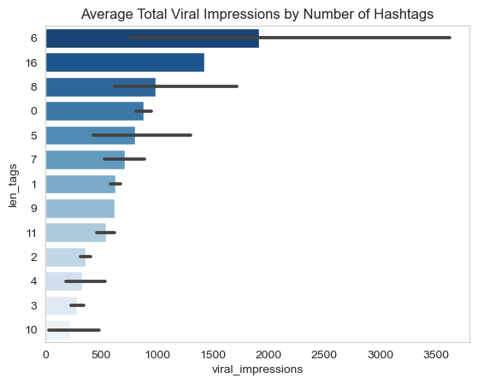
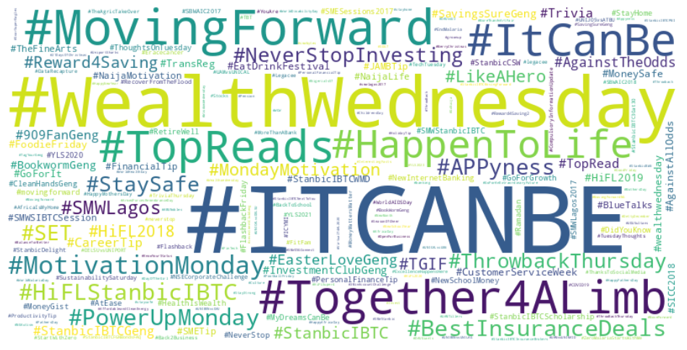
What Hashtags follow Above Average Viral Posts
The word cloud of hashtags for posts with viral values in excess of the average looks no different than the general word cloud for hashtags of the whole dataset.
This may imply that hashtags are not a clear indicator of virality.
However, more viral posts have about 6 hashtags.
Please see the jupyter notebook for more information.

Slide 56
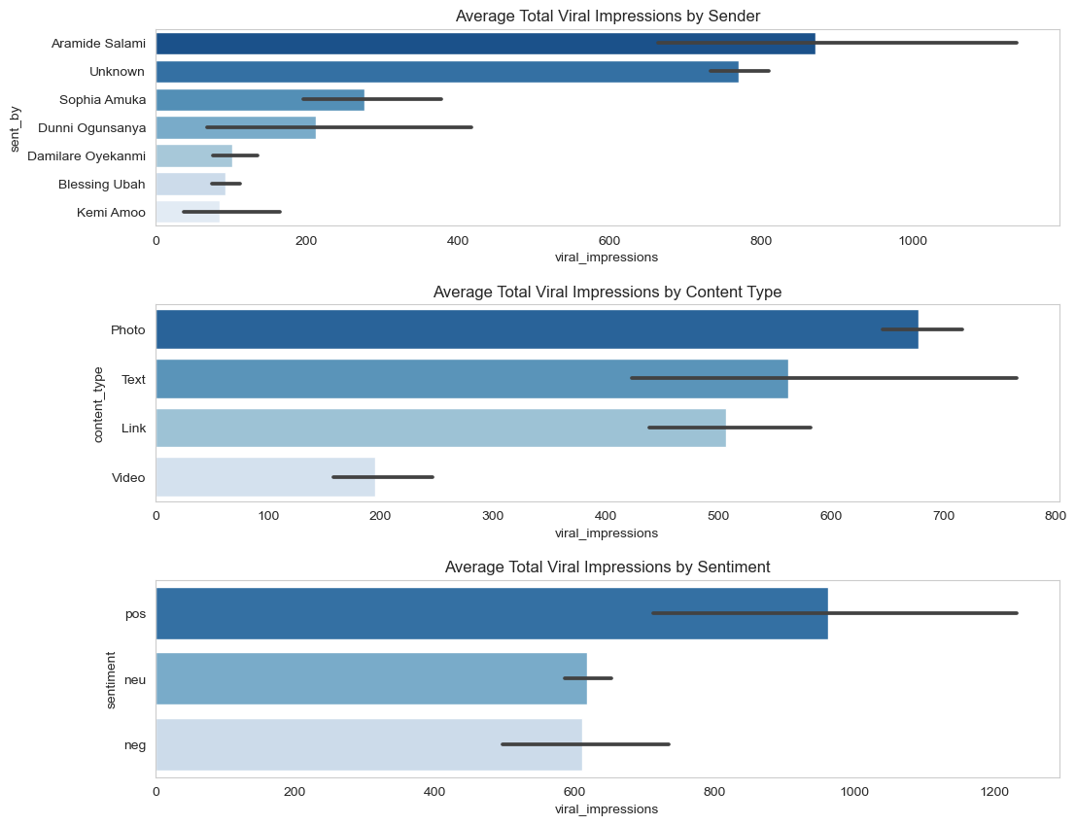
Which Categorical Variables Favour Virality?
On average, Aramide Salami is the sender whose posts have the highest amount of virality.
Photo posts generally are more viral than others.
Posts with a positive sentiment are more likely to go viral.
Please see the jupyter notebook for more information.

Slide 57
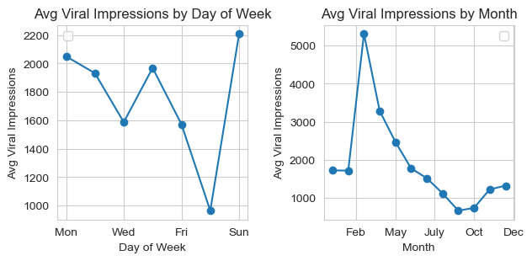
When do Posts Go Viral?
On average, posts sent on Sundays are the most viral.
The month of March is the hottest month for virality.
Please see the jupyter notebook for more information.

Slide 58
Section 4 Insights Drawn From Statistical Analysis

Slide 59

Statistical Analysis - Hypothesis Testing
Statistical tests are a set of mathematical techniques used to make inferences about populations or data based on a sample of that data.
They are used to draw conclusions about the characteristics of a population or the relationship between variables.
Our exploratory analysis has raised several hypotheses about the relationship between variables in our dataset.
We’ll use statistical tests to test the significance of those theses and make inferences from them, including ANOVA, Regression Analysis, Correlation & T/U-Tests.
Please see the jupyter notebook for more information.

Slide 60
Statistical Tests - ANOVA
Analysis of Variance (ANOVA), which tests whether there are any statistically significant differences among the means of the numeric variable across the categorical groups. The ANOVA test returns an F-statistic and a p-value.
The F-statistic indicates how much the variance in the dependent variable can be attributed to the independent or categorical variable. Higher F-values suggest larger differences among group means relative to the variation within each group implying that there might be significant differences among group means.
The p-value tells us the probability of observing the observed F-statistic by random chance. Smaller p-values (typically less than a chosen significance level, often 0.05) indicate stronger evidence that the F-statistic is not due to chance, i.e., it is statistically significant. This indicates that there are significant differences among the group means.
Please see the jupyter notebook for more information.

Slide 61

Statistical Tests – Correlation & T/U-Tests
Correlation analysis, which measures the strength and direction of the linear relationship between two continuous numeric variables. The Pearson correlation coefficient (r) is commonly used for normally distributed data, while the Spearman rank correlation coefficient (ρ) is suitable for non-normally distributed data or when the relationship may be nonlinear.
T-Test or Mann-Whitney U Test, which compares the means of two numeric variables between two groups to determine whether there is a significant difference between the two groups. T-test is for normally distributed data and Mann-Whitney U test is for non-normally distributed data. A higher absolute statistic value (whether t-statistic or U-statistic) is often associated with a smaller p-value, which indicates stronger evidence against the null hypothesis, i.e., we would accept the visuals from our plot.
Please see the jupyter notebook for more information.

Slide 62
Coefficients, which represents the change in a dependent variable that is associated with a one-unit change in the corresponding independent variable, holding all other variables constant.
Standard errors, which measure the variability or uncertainty in the coefficient estimates. Smaller errors indicate more precise estimates.
T-statistics & P-values, which measures how many standard errors the coefficient is away from 0.
R-squared, which measures the proportion of variance in the dependent variable explained by the independent variable. A higher r-squared indicates that a larger portion of the variance in the dependent variable is explained by the independent variables.
F-statistic, which tests the overall significance of the model. A low p-value for the F-statistic suggests that the model is statistically significant.
Residuals, which are the difference between observed and predicted values. Ideally, residuals should be randomly distributed and exhibit no systemic patterns.
Durbin-Watson statistic, which checks for autocorrelation in the residuals. A value close to 2 suggests no significant autocorrelation.
Confidence Interval, which provide a range within which the true population parameter (the coefficient) is likely to fall. It's often more informative than just looking at point estimates (coefficients)..
Assumption checks, which check for the model’s adherence to the assumptions of linearity, independence of errors, homoscedasticity (constant variance of residuals), and normality of residuals.
Statistical Tests – Regression Analysis
Regression analysis, which models the relationship between two numeric variables by fitting a linear equation to the data. It helps us understand how one variable changes as the other changes. Linear regression coefficients helps us assess the strength and direction of the relationship.
The results to be interpreted from a regression analysis include coefficients, standard errors, T-statistics & p-values, r-squared, F-statistic, residuals, Durbin-Watson statistic, confidence intervals and assumption checks.
Please see the jupyter notebook for more information.

Slide 63
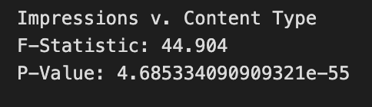
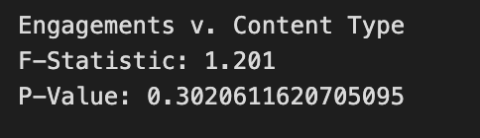
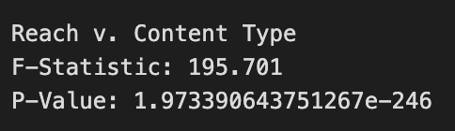
Is Content Type Related to any Engagement Metric?
In the EDA section on Categorical Features – Content Type, we saw that on average, Poll was the highest content type by Impressions and Engagements, Text was the highest content type by Reach.
When this relationship is tested for statistical significance, the relationship between engagements and content type is not statistically significant and the chart should be rejected for inference.
Between impressions and reach, the relationship between reach and content type is more statistically significant.
We can therefore infer that text posts are more likely to have wider reach Facebook provides the highest impression and engagements and Twitter provides the highest reach.
Please see the jupyter notebook for more information.

Slide 64
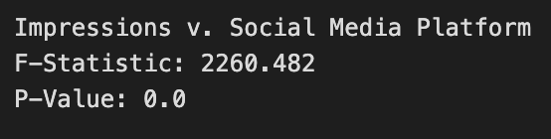


Which Network yields the highest Engagement?
In the EDA section on Categorical Features – Network, we saw that on average, Facebook provides the highest impression and engagements, and Twitter provides the highest reach.
When these relationships are tested for statistical significance, all of them are statistically significant, inferring that network explains some variance (has some relationship) within each engagement variable.
The smallest explained variance is with Engagements and the highest is with Reach.
We can therefore infer that Facebook will likely yield the highest impressions and Twitter will yield the highest Reach.
Please see the jupyter notebook for more information.

Slide 65



Which Sender posts the most engaging posts?
In the EDA section on Categorical Features – Sender, we saw that on average, the highest impressions and engagements are from posts sent by Damilare Oyekanmi and the highest reach are from posts sent by Kanayo Obiano, Lilian Ibekwe, Philip Nwagwunor and Rebecca Oyebode.
When these relationships are tested for statistical significance, all of them are statistically significant, inferring that sender explains some variance (has some relationship) within each engagement variable.
The smallest explained variance is with Engagements and the highest is with Reach.
We can therefore infer that posts by Damilare Oyekanmi will likely yield the highest impressions and posts from Kanayo Obiano, Lilian Ibekwe, Philip Nwagwunor and Rebecca Oyebode will yield the highest Reach.
Please see the jupyter notebook for more information.

Slide 66


What are the peak times for user engagement?
In the EDA section on Engagement Metrics by Hour, we saw that on average when aggregated by Hour, engagements see an upward trend as the day progresses across all engagement metrics.
When tested using Spearman’s rank correlation, we see that hour is only slightly correlated with any engagement metric.
Regression analysis also showed that there is no linear relationship that can be modeled between hour and any engagement metric.
The combination of high u-statistic and low p-value infers that there is a significant and consistent difference in each metric when grouped by hour. This may infer that Hour is a predictor of each engagement metrics and 9pm is a great time for posting.
Please see the jupyter notebook for more information.

Slide 67


Is Year a predictor of user engagement?
In the EDA section on Engagement Metrics by Year, we saw that on average when aggregated by Year, impressions and engagements see an upward trend as the year progresses and reach sees the reverse.
When tested using Spearman’s rank correlation, we see that there is a more significant correlation between year and all engagement metrics than compared with Hour.
Regression analysis also showed that there is no linear relationship that can be modeled between year and any engagement metric.
The combination of high u-statistic and low p-value infers that there is a significant and consistent difference in each metric when grouped by year. This may infer that Year is a predictor of each engagement metrics and each later will on average see higher engagement metrics.
Year is likely a better time-period predictor for impression metrics than other time periods.
Please see the jupyter notebook for more information.

Slide 68

Testing Trends in General Metrics
For other general metrics beyond engagements, we see a significant upward trend in link clicks and video views and a significant decline in shares. Other metrics have flat trendlines or only slight inclines.
Please see the jupyter notebook for more information.

Slide 69

Testing Trends in General Metrics - Correlation
Pearson correlation poorly assesses the relationship between variables because they are not normally distributed.
When tested using spearman rank correlation, we find that year is more correlated with general metrics than hour.
In particular, the highest correlations are between year and comments, likes, reactions and shares.
Many metrics are correlated with each other and explaining the variance in certain variables requires models that combine many independent variables. In regression analysis, this is called Multiple Linear Regression.
Please see the jupyter notebook for more information.

Slide 70

Testing Trends in General Metrics – Regression Analysis - Impressions
The model with the highest r squared for modeling the impressions feature is the model with parameters as network, content type and year. R-squared is low at 16.5%
Parameter coefficients for document, photo and text content type are statistically insignificant, meaning that their coefficient values are no different from zero.
According to this model, all features except Poll content type and year negatively impact the values in the impression feature.
The model’s F-statistic (713, p-value 0) is significant implying that the model is statistically significant and at least one of the model parameters is related to the impressions feature.
The confidence intervals for most statistically significant features are left of zero on the number line, i.e., they are negative values.
The standard errors on a few significant features are high implying that any predictions from the model will be far from the observed values.
The Durbin-Watson statistic (1.687) implies that the model’s errors are independent and there is no strong case for overfitting or underfitting.
Please see the jupyter notebook for more information.

Slide 71

Testing Trends in General Metrics – Regression Analysis - Reach
The model with the highest r squared for modeling the reach feature is the model with parameters as network, content type and year. R squared is high at 85.3%
Parameter coefficients for document, photo and poll content type are statistically insignificant, meaning that their coefficient values are no different from zero.
All features except Twitter network, video content type and year negatively impact the values in the reach feature.
The model’s F-statistic (>2k, p-value 0) is significant implying that the model is statistically significant and at least one of the model parameters is related to the reach feature.
The confidence intervals for most statistically significant features are left of zero on the number line, i.e., they are negative values.
The standard errors are generally high implying that any predictions from the model will be far from the observed values.
The Durbin-Watson statistic (1.8) implies that the model’s errors are independent and there is no strong case for overfitting or underfitting.
However, this model confirms the charts we’ve plotting regarding the Reach variable.
Please see the jupyter notebook for more information.

Slide 72

Testing Trends in General Metrics – Regression Analysis – Engagement Rate per Reach
The model with the highest r squared for modeling the engagement rate per reach feature is the model with parameters as network, content type, impressions, reach, engagements, reactions and likes. R squared is low at 22.2%
This model has been filtered to remove parameters with insignificant coefficients. This raises concerns of whether the model is overfit to its parameters and if it can generalize to the fuller dataset.
All features except Instagram network, impressions and reactions negatively impact the values in the engagement rate per reach feature.
The model’s F-statistic (616, p-value 0) is significant implying that the model is statistically significant and at least one of the model parameters is related to the reach feature.
The confidence intervals for most statistically significant features are left of zero on the number line, i.e., they are negative values.
The standard errors are generally low implying that any predictions from the model will be close to the observed values.
The Durbin-Watson statistic (1.895) implies that the model’s errors are independent and there is no strong case for overfitting or underfitting.
Please see the jupyter notebook for more information.

Slide 73

Testing Trends in General Metrics – Regression Analysis – Shares
The model with the highest r squared for modeling the engagement rate per reach feature is the model with parameters as network, content type, year, impressions, reach and link clicks. R squared is low at 21.1%
All features except impressions negatively impact the values in the engagement rate per reach feature.
The model’s F-statistic (740, p-value 0) is significant implying that the model is statistically significant and at least one of the model parameters is related to the reach feature.
The confidence intervals for most statistically significant features are left of zero on the number line, i.e., they are negative values.
The standard errors are generally low implying that any predictions from the model will be close to the observed values.
The Durbin-Watson statistic (1.894) implies that the model’s errors are independent and there is no strong case for overfitting or underfitting.
Please see the jupyter notebook for more information.

Slide 74

Testing Trends in General Metrics – Regression Analysis – Link Clicks
The model with the highest r squared for modeling the link clicks feature is the model with parameters as network and content type. R squared is very high at 96.4%
This model has been filtered to remove parameters with insignificant coefficients. This raises concerns of whether the model is overfit to its parameters and if it can generalize to the fuller dataset.
The model’s F-statistic (9958, p-value 0) is significant implying that the model is statistically significant and at least one of the model parameters is related to the reach feature.
The standard errors are very low implying that any predictions from the model will be close to the observed values.
The Durbin-Watson statistic (2.0) implies that the model’s errors are independent and there is no strong case for overfitting or underfitting.
However, the sample size is about 2% of the fuller dataset.
Please see the jupyter notebook for more information.

Slide 75

Testing Trends in General Metrics – Regression Analysis – Link Clicks 2
When we generalize the model to the fuller dataset, the r—squared drops to 2%. This supports the theory that the previous model was overfit.
However, standard error remains low, f-statistic remains significant, and Durbin-Watson statistic remains near perfect.
This implies that the independent features explain some of the variance in the links click feature however, the relationship is likely non-linear and using a line equation to model the dataset is inadequate
Please see the jupyter notebook for more information.

Slide 76

Testing Trends in General Metrics – Regression Analysis – Video Views
The model with the highest r squared for modeling the video views feature is the model with parameters as network, content type and year. R squared is low at 14.7%
All features except Twitter network and shares positively impact the values in the engagement rate per reach feature.
The model’s F-statistic (519, p-value 0) is significant implying that the model is statistically significant and at least one of the model parameters is related to the reach feature.
The confidence intervals for most statistically significant features are right of zero on the number line, i.e., they are positive values.
The standard errors are generally low implying that any predictions from the model will be close to the observed values.
The Durbin-Watson statistic (1.805) implies that the model’s errors are independent and there is no strong case for overfitting or underfitting.
Please see the jupyter notebook for more information.

Slide 77

Testing Trends in General Metrics – Regression Analysis - Results
We can confidently accept that features like year, network and content type are related to Reach.
For other models with low r squared, we can only determine which feature are closely related to the dependent variable by plotting residual plots of each independent variable and the residuals.
Other general metrics like engagements, engagements per impressions, reactions, likes, comments, and all clicks have poor linear models.
This may imply that the features cannot be linearly modeled, and other types of non-linear modeling techniques should be considered.
Please see the jupyter notebook for more information.

Slide 78

Testing Trends in General Metrics – U - Test
We’ve already seen that the features are not normally distributed. Therefore, we’ll favor the Mann-Whitney U-Test to test the significance of group means.
From our analysis, there is there is a statistically significant difference between year and each general metric indicating that the relationship might be non-linear.
This confirms our conclusion from the regression analysis.
Please see the jupyter notebook for more information.

Slide 79
Section 5 Build a Dashboard with Tableau

Slide 80


Pie chart showing success rate for all Sites
CCAFS LC-40 is the launch site with the most successful launches

Slide 81

Pie chart showing Site with highest success ratio
KSC LC-39A is the launch site with the highest success ratio

Slide 82



Scatterplot showing Payload v. Launch Outcome
We can see success v. failure ratio based on payload range.
The range 5k – 10k has the lowest launch success rate.
The FT booster has the highest success rate and v1.1 has the lowest

Slide 83
Section 6 Predictive Modelling

Slide 84
Predictive Modelling
Our initial statistical analysis was unable to successful model the relationship between many features in the general metrics list and the correlated features.
Our initial assumption was that these variables are not linearly related.
We tested this assumption using predictive analytics and deploying linear and non-linear models to the entire general metrics dataset.
Please see the jupyter notebook for more information.

Slide 85
Predictive Modelling – Linear Models
We modeled the data using Linear Regression and Linear Support Vector Machine Models.
The independent features in the model where the remaining general metrics and the categorical features.
Please see the jupyter notebook for more information.

Slide 86


Predictive Modelling – Linear Models
We modeled the data using Linear Regression and Linear Support Vector Machine Models.
The independent features in the model where the remaining general metrics and the categorical features.
Engagements, Reactions, Reach, Comments and All Clicks returned near perfect models with generally low errors.
We used tree models to determine which features were most important to the model results.
Please see the jupyter notebook for more information.

Slide 87



Predictive Modelling – Tree Models
We modeled the data using Decision Tree, Random Forest, Gradient Boosted Trees and XGBoost. The Gradient Boosted Trees performed best overall.
All the tree models out-performed the linear models for variables with poor linear models.
Tree model errors where on average higher than linear model errors.
The tree models in python’s Sci-kit learn library include a method that lists the most important independent variables.
Please see the jupyter notebook for more information.

Slide 88


Important Features & Residual Plots
The Residual Plots from the Linear Regression and Gradient Boosted Trees Models show heteroskedasticity and existence of outliers in the model parameters.
This may imply that parameter estimates are inefficient and confidence intervals are unreliable.
However, when we conduct regression analysis with the features that were important to the gradient boosted trees model, our regression metrics significantly improve across all general metrics.
Please see the jupyter notebook for more information.

Slide 89

Predictive Models - Regression Analysis
- Impressions
Using the important features from our predictive models, r-squared for Impressions increase by nearly 40 points to 55%
There are no statistically insignificant parameters in this model.
The model’s F-statistic (4893, p-value 0) is significant implying that the model is statistically significant and at least one of the model parameters is related to the Impressions feature.
The standard errors are significantly smaller in this model implying that any predictions from the model will be close to the observed values.
The Durbin-Watson statistic (1.747) implies that the model’s errors are independent and there is no strong case for overfitting or underfitting.
Please see the jupyter notebook for more information.

Slide 90

Predictive Models - Regression Analysis
– Engagements
Using features relevant to the Gradient Boosted Trees prediction model, the r-squared for the Engagements feature moved 100 points from 0% to 100%.
All parameter coefficients are statistically significant.
The model’s F-statistic (20m, p-value 0) is significant implying that the model is statistically significant and at least one of the model parameters (likely all) is related to the Engagements feature.
The range of values for the confidence intervals is very small indicating that the model provides a precise estimate of the parameters, it fits the data well and the estimated parameter is highly reliable.
The standard errors are very low implying that any predictions from the model will be nearly identical to the observed values.
The Durbin-Watson statistic (2.002) implies that the model’s errors are independent and there is no strong case for overfitting or underfitting.
Please see the jupyter notebook for more information.

Slide 91

Predictive Models - Regression Analysis
- Reach
This model only increases the r-squared by 1 point to 86.2%
Parameter coefficients for video views are statistically insignificant, meaning that their coefficient values are no different from zero.
The model’s F-statistic (>2k, p-value 0) is significant implying that the model is statistically significant and at least one of the model parameters is related to the Reach feature. This is unchanged from the correlation analysis.
The standard errors are significantly lower than the correlation-based regression analysis.
The Durbin-Watson statistic (1.8) implies that the model’s errors are independent and there is no strong case for overfitting or underfitting. This is unchanged from the correlation analysis.
Please see the jupyter notebook for more information.

Slide 92

Predictive Models - Regression Analysis
– Reactions
Using features relevant to the Gradient Boosted Trees prediction model, the r-squared for the Reactions feature moved from 0% to 94%.
All parameter coefficients are statistically significant.
The model’s F-statistic (18k, p-value 0) is significant implying that the model is statistically significant and at least one (likely all) of the model parameters is related to the Reactions feature.
The range of values for the confidence intervals is very small indicating that the model provides a precise estimate of the parameters, it fits the data well and the estimated parameter is highly reliable.
The standard errors are very low implying that any predictions from the model will be nearly identical to the observed values.
The Durbin-Watson statistic (1.901) implies that the model’s errors are independent and there is no strong case for overfitting or underfitting.
Please see the jupyter notebook for more information.

Slide 93

Predictive Models - Regression Analysis
– Comments
Using features relevant to the Gradient Boosted Trees prediction model, the r-squared for the Comments feature moved from 0% to 41%.
The model’s F-statistic (837, p-value 0) is significant (and higher than the correlation-based model) implying that the model is statistically significant and at least one of the model parameters is related to the reach feature.
The standard errors for significant features are generally low implying that any predictions from the model will be close to the observed values.
The Durbin-Watson statistic (1.8) implies that the model’s errors are independent and there is no strong case for overfitting or underfitting.
Please see the jupyter notebook for more information.

Slide 94

Predictive Models - Regression Analysis
– Shares
Using features relevant to the Gradient Boosted Trees prediction model, the r-squared for the Shares feature moved from 21% to 47%.
The model’s F-statistic (1326, p-value 0) is significant implying that the model is statistically significant and at least one of the model parameters is related to the reach feature.
The standard errors are generally low implying that any predictions from the model will be close to the observed values.
The Durbin-Watson statistic (1.848) implies that the model’s errors are independent and there is no strong case for overfitting or underfitting.
Please see the jupyter notebook for more information.

Slide 95

Predictive Models - Regression Analysis
– Link Clicks
Using features relevant to the Gradient Boosted Trees prediction model, the r-squared for the Link Clicks feature moved from 2% to 27%.
The model’s F-statistic (2197, p-value 0) is significant implying that the model is statistically significant and at least one of the model parameters is related to the Link Clicks feature.
The standard errors are significantly lower in this model implying nearly accurate predictions.
The Durbin-Watson statistic (1.996) implies that the model’s errors are independent and there is no strong case for overfitting or underfitting.
Please see the jupyter notebook for more information.

Slide 96

Predictive Models - Regression Analysis
– All Clicks
Using features relevant to the Gradient Boosted Trees prediction model, the r-squared for the Engagements feature moved from 0% to 99.4%.
The model’s F-statistic (51k, p-value 0) is significant implying that the model is statistically significant and at least one of the model parameters (likely all) is related to the reach feature.
The standard errors are very low implying that any predictions from the model are nearly identical to observed values.
The Durbin-Watson statistic (2.0) implies that the model’s errors ae independent and there is no strong case for overfitting or underfitting.
Please see the jupyter notebook for more information.

Slide 97

Predictive Models - Regression Analysis
– Video Views
This model is identical to the correlation model, indicating that Video Views may not be linearly related to the other features in the dataset.
However, when we consider that the tree models were unable to provide any better predictions than this, it is likely the parameters or features related to Video Views are not being used in our models.
This means we have been unable to explain a significant amount of the variance in this feature.
Please see the jupyter notebook for more information.

Slide 98
Conclusions
Most of the metrics in the general metrics list are linearly related with each other, the categorical features and date.
This means that increasing or reducing the values of a specific metric is achievable by increasing or decreasing the values of its related independent variables.
We used predictive modeling to determine the best features that increase model accuracy.
Impressions is better modeled using tree models than a linear model. However, linear models are able to explain about 55% of the variance in impressions.
We are unable to successfully model the Video Views features to significantly increase accuracy.

Slide 99
Thank you!

